Slide 1
Work Experience 2025
Mrs E Ellis - Careers and Work-Related Learning Advisor

Slide 2
Work experience
Students in year 12 will take part in work experience from:
Monday 17th to Friday 21st March 2025
We are expecting all year 12 students to attend a work placement during this week
Notes:
Year 12 work experience will run from Monday 22nd April to Friday 26th April 2024
We are expecting all students to attend a work placement during this week

Slide 3
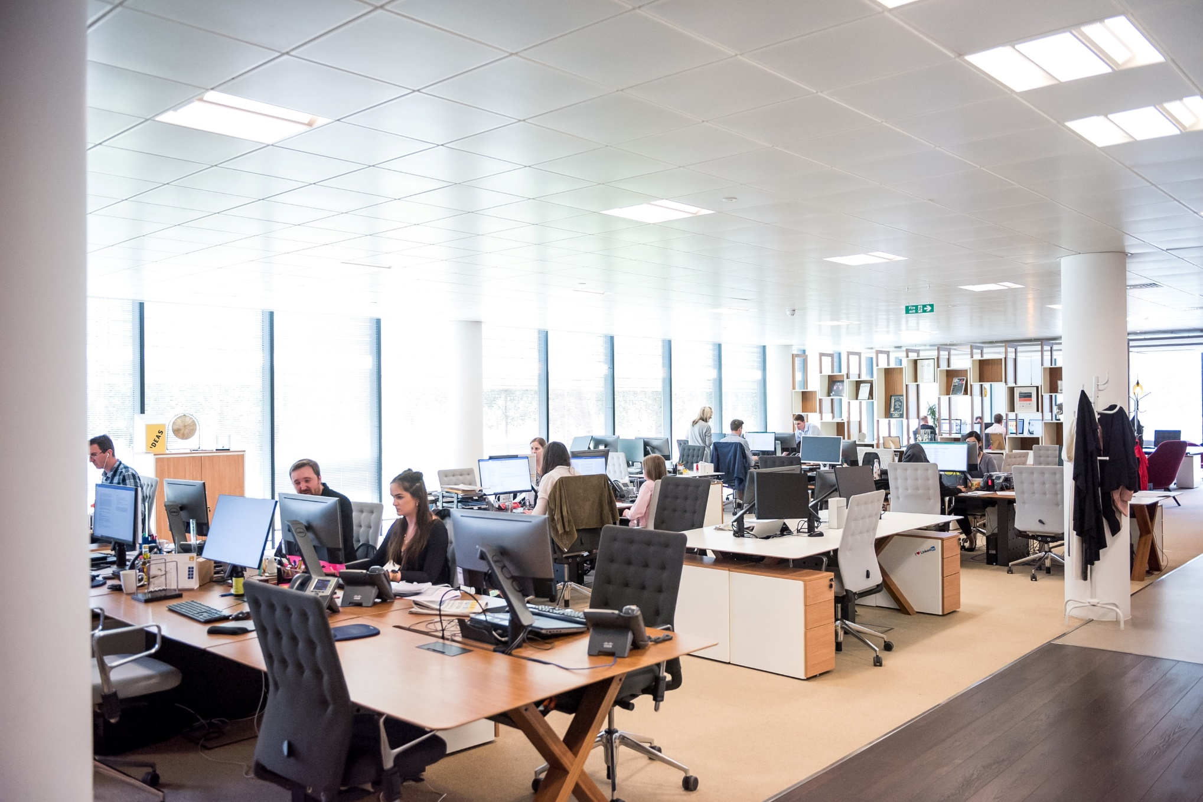
Why is work experience so important?
Prepare you for your future career
To develop an understanding of employment and the world of work
Develop and reflect on the skills you have
To build confidence
Enhance University and Apprenticeship applications
Enhance any applications you make for part time employment
Notes:
Why is work experience important?
Prepare you for your future career
To develop an understanding of employment and the world of work
Develop and reflect on the skills you have
To build confidence
Enhance University and Apprenticeship applications
Enhance any applications you make for part time employment

Slide 4
Finding a Placement
Students to find their own work placement.
Contact local employers to see if they take work experience students
This experience is intended to give you a meaningful experience of the workplace
Some placements are available through the careers team but only in exceptional circumstances.
Speak to Mrs Ellis ASAP if you are having issues in finding something.
Notes:
We are expecting all students to find their own work placement.
This will involve contacting local employers and asking them if they take work experience students – you will have sessions on the best way to do this over the next few weeks
Your placement is intended to give you a meaningful experience of the workplace by showing you what it is like to search and apply for a job as well as what it is like to be in a working environment.
Some placements are available through the careers team but only in exceptional circumstances. Speak to Mrs Ellis if you are having issues in finding something.

Slide 5
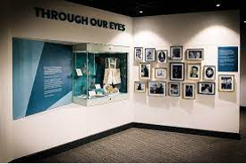
Examples of work placements
Local primary schools (may require a DBS when
over 16)
Community Pharmacy
Solicitors
Museums
Libraries
Charity/ Voluntary Organisations
Accountants
If your parents have an interesting job, why not see if they will take a friend and vice versa
Notes:
Placements last year were in a variety of sectors
Local Primary Schools – often find success if you are a former student
Community Pharmicies – many students had placements in pharmacies that were close to their home and had dispensing experience
Solicitors – Many opportunities in small and local solicitors firms – students attended court and sat in on cases with barristers as a result
Museums – these proved to be fantastic placements last year, with students getting a wide range of experience. Local examples the National Coal Mining Museum and the Holocaust Centre at Huddersfield University
Libraries – lots of local libraries accepted students
Accountants – often smaller local accountants will take students as well as bigger ones in the city

Slide 6
What makes a good placement?
Gaining an experience of the workplace
Furthering your skills and knowledge
You may not necessarily be able to secure a placement in the job that you would like to do in the future
All experience is good experience and gives you transferable skills.
No placements can take place abroad
All employers must have Employers Liability Insurance to safeguard students
Notes:
Work experience is about gaining an experience of the workplace and furthering your skills and knowledge.
You do not necessarily need to secure a placement in the job that you would like to do in the future – as you are for example unlikely to be accepted on placement shadowing the head of a company but could secure a placement in the HR department – all experience is good experience and gives you transferable skills that you will use in the future
No placements can take place abroad - this is for health and safety reasons
Any placement should have the correct Employers Liability Insurance in place to safeguard students – this is unlikely to be in place at a sole trader business for example

Slide 7
Contacting an employer
Contact an employer by phone or email
Check the dates are available
You then need to get the details of the person who is responsible for your placement
This needs to be someone who can provide details of Risk Assessments and Employers Liability Insurance
An employer may ask you to visit them in person or send a CV
Notes:
Contact an employer by phone or email in the first instance.
Check the dates are available with the employer – everyone will be out on the same week Mon 22nd APR to Fri 26th APR
You then need to get the details of the person who is responsible for you on placement who can provide details of Risk Assessments and Employers Liability Insurance – without this placements will not be approved.
An employer may ask you to visit them in person or send a CV before they agree to host your placement – this is normal in some cases and resources are available in your student info pack to help or you can speak to a member of the careers team.

Slide 8
Unifrog
We are using Unifrog
Students should have received a welcome email to your school email address
Check this and set up your password.
You will receive further guidance on how to add your placement to Unifrog
Student and Parent Information booklet
Please see Mrs Ellis if you do not receive your welcome email
Notes:
We are using Unifrog for the administration side of the work placement.
You should have received a welcome email on Friday.
Check your School email for a welcome email and set up your password.
You will receive a session on how to use Unifrog to add your placement – there is also information in the booklet you have been given and a copy has also been emailed to your parents this week.
You will also be given a student and parent information booklet that will go through the process, this will also be sent home electronically.
If you have not received your email by the end of next week please see Mrs Ellis.

Slide 9
Frequently Asked Questions - FAQs
Do I have to go on Work Experience?
Can I work with a family member?
I want to be a doctor. How do I get a placement that is directly relevant?
What if I can't find a placement?
Can I work in a factory?
What is employer's liability insurance?
Can I change the dates of my work experience?
Notes:
Do I have to go on Work Experience?
Yes every student is expected to take part in the work experience week. Exceptional circumstances can be discussed with Mrs Ellis
Can I work with a family member?
Yes you can but insurance and risk assessments will need to be provided just the same.
I want to be a doctor. How do I get a placement that is directly relevant?
Medical placements can be challenging to secure. Some local hospitals run work experience schemes so check on their websites. Some students may be fortunate that they have family members in the profession, however if this is not you then please remember all experience is good experience for your future.
What if I can't find a placement?
We expect all students will find a work experience placements however the careers team will be arranging work related learning opportunities in school in the unlikely case of no placement being secured
Can I work in a factory?
Your safety is of the upmost important to us and for this reason a shop floor environment of a factory may not be approved however this does not mean you could not undertake your placement in the factory office.
What is employer's liability insurance?
This is a business insurance that covers claims made against a business by clients, contractors, or members of the public in the event of a accidental injury or damage to their property
Can I change the dates of my work experience?
No, these dates as the same for every year 10 students and are unable to be changed.
What if I can't find my own placement?
The careers team do have access to a small number of employers who have expressed an interest in welcoming a work experience student however these will only be given to students who have already tried to find their own.

Slide 10
Timeline for Work Experience
September 2024 - Launch of Work Experience and access to Unifrog
September 2024 to December 2024 - Students source a placement
Friday 13th December 2024 - Deadline for uploading placement to Unifrog
December 2024 – March 2025
– Placements checked and finalised by the careers team
– Students attend preparation sessions on expectations of the workplace and visit their employer
January 2025 – mock interview
Monday 17th to Friday 21st March 2025 - Students out on placement week
March 2025 – reflections and feedback from employer
Notes:
September 2023 - Launch of Work Experience and access to Unifrog
September 2023 to January 2024 - Students source a placement – sessions in form time to help with this
Friday 12th January 2024 - Deadline for uploading placement to Unifrog
January 2024 – April 2024
– Placements checked and finalised by the careers team
– Students attend preparation sessions on expectations of the workplace and visit their employer
22nd April to 26th April 2024 - Students out on placement week
June/July 2024 – reflections and feedback from employer

Slide 11
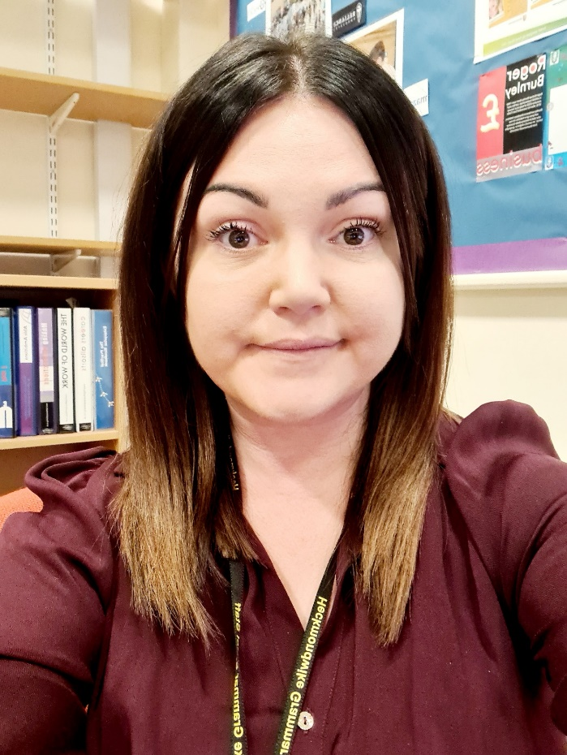
Who to contact if you need support
Mrs J Haigh
jhaigh@heckgrammar.co.uk
Mrs E Ellis
eellis@heckgrammar.co.uk
Based in B013 at the back of the Swann Hall.
An information booklet will be given to you during form time and also electronically sent to parents/carers.
Notes:
I am the contact for work experience for year 12 and can help you with many things.
Look out for sessions after school about finding work placements/adding them to Unifrog in the bulletin.
Resources will be given to you next week as well as sent home to your parents electronically.

