Slide 1
Sixth Form Bulletin

Slide 2
Y12

Slide 3


Slide 4
Work Experience Launch
Look out for forms and further details on ClassCharts regarding Year 12 Work Experience.
A video launch will be shown in Tuesday's tutor.

Slide 5


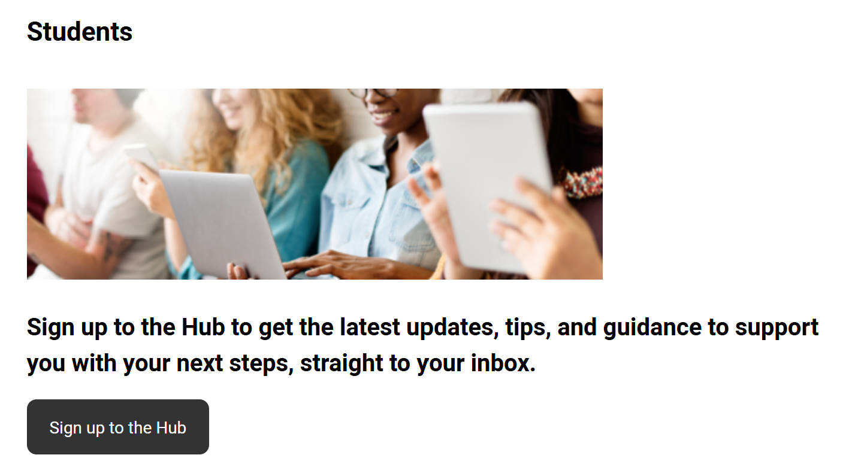
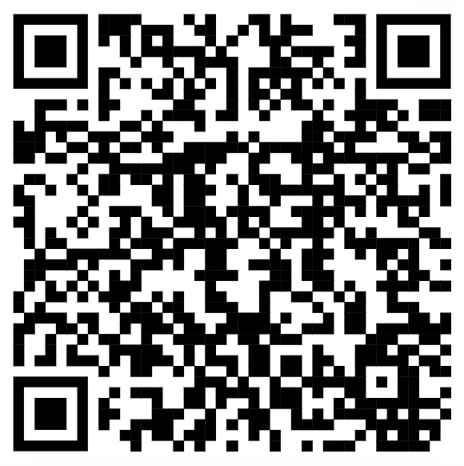

Slide 6

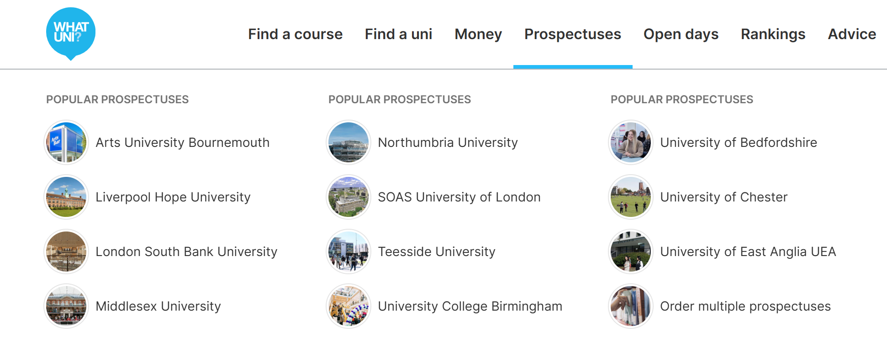
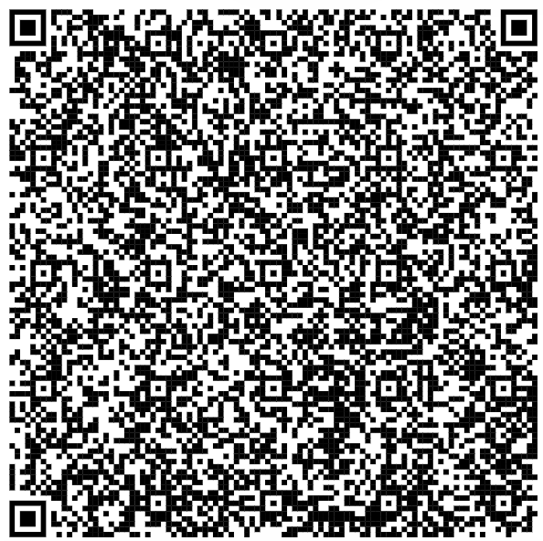
University Open Days and Events
Check out open days and events at universities that are occurring this year! Don't forget to check out the prospectuses.

Slide 7
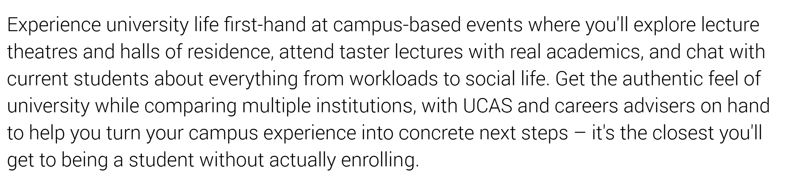
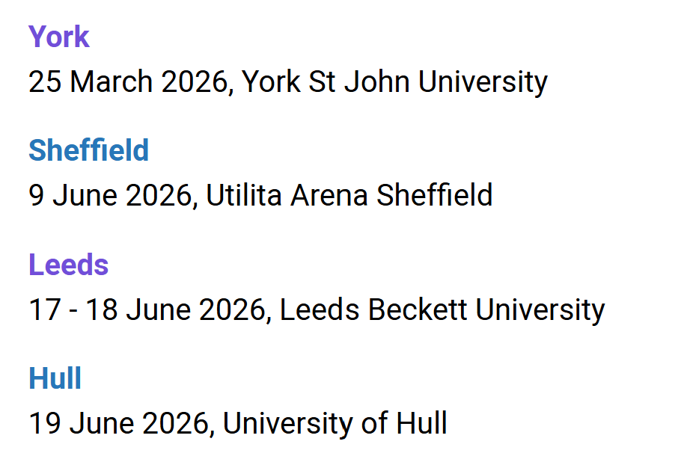
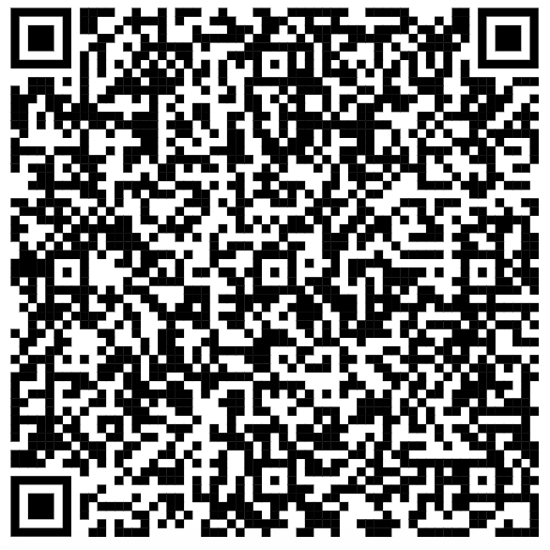
UCAS Discovery Days

Slide 8

Children in Need – upcoming events
Come join the fun at lunchtime Wednesday 12th November to support all the stalls there.
Open at 12:30
Remember to bring some loose change!

Slide 9

Children in Need – upcoming events
Come support our talented musicians on Thursday 13th November as they play to raise money!
Lunch time in the Swann Hall
£1 entry – all towards an excellent cause.

Slide 10

Children in Need – upcoming events
Participate in the staff ice bucket challenge as our hero staff dare to take part in an effort to raise money for an important need!
Friday 14th November – Junior Yard
If you want to buy raffle tickets with the chance to tip the water, they are available to buy beforehand.

Slide 11
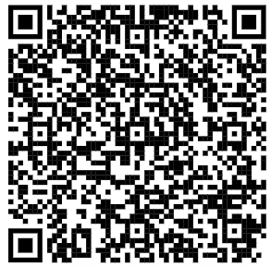

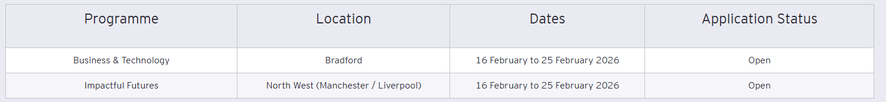
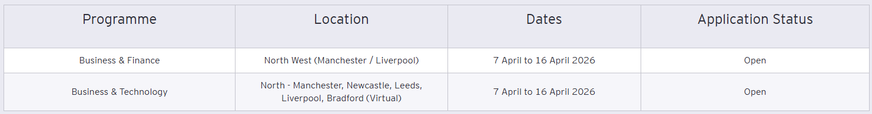
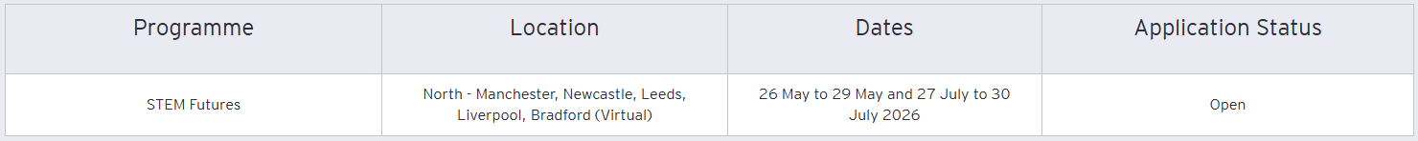
Paid Work Experience Opportunities
Smart Futures. Opportunities to apply for paid work experience in the sectors below during the school holidays. Use the QR code to get more details.

Slide 12
Y13

Slide 13
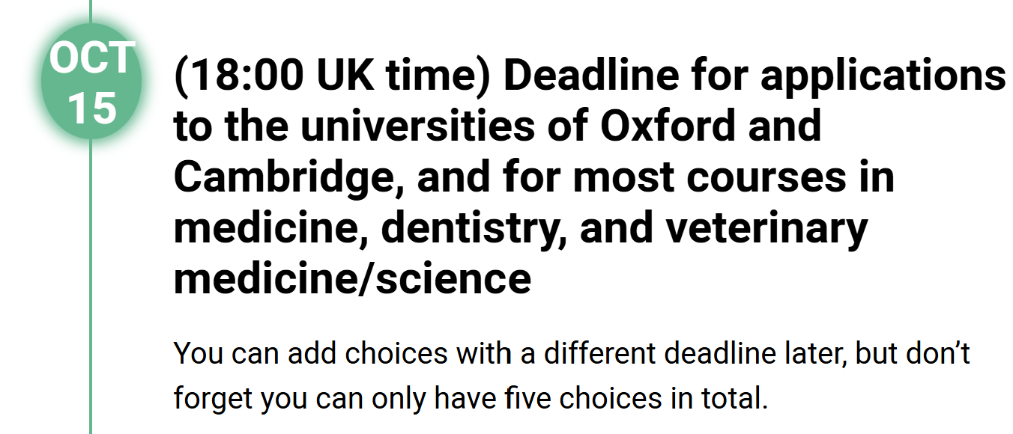
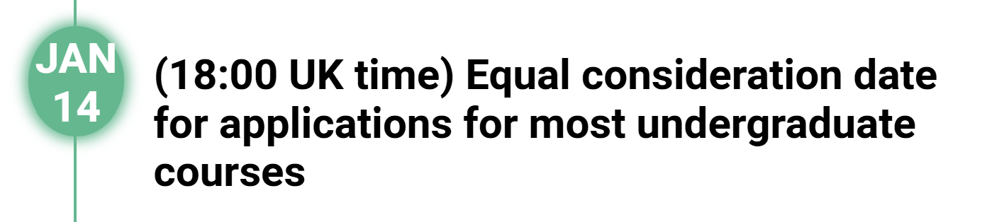
Your UCAS application must be completed before we break up for Christmas to allow the checkers to check it and send it before the deadline.

Slide 14
University Open Days and Events
It is still not too late to visit universities.
Check out upcoming open days and events to help you with your decision.

Slide 15
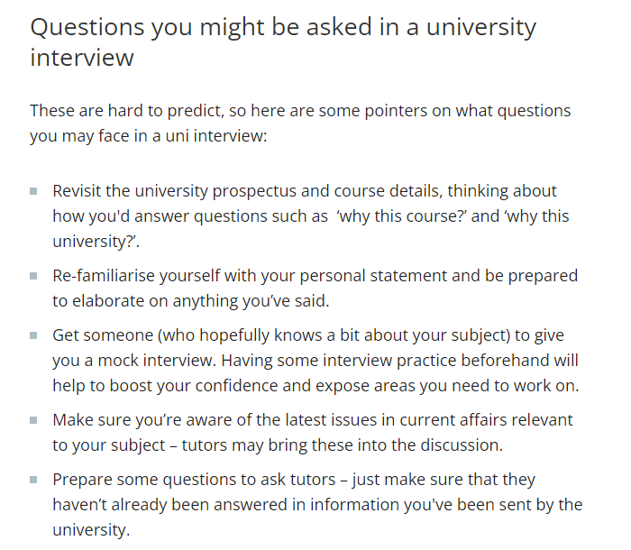
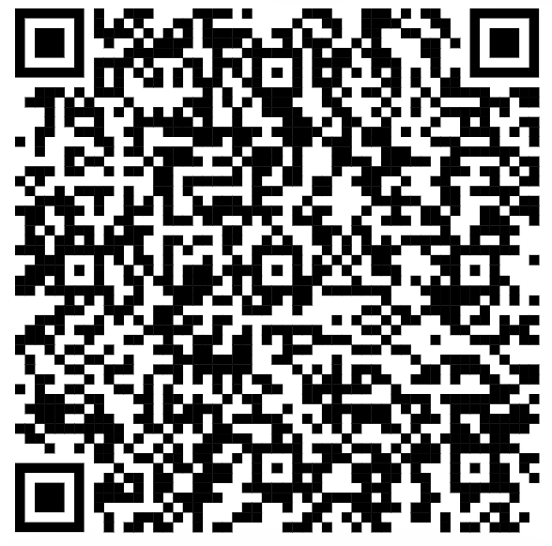
Preparing for Interviews
https://www.theuniguide.co.uk/advice/ucas-application/university-interviews-how-to-prepare
This guide gives some handy tips on how to prepare for university interviews.

Slide 16
Children in Need – upcoming events
Come join the fun at lunchtime Wednesday 12th November to support all the stalls there.
Open at 12:30
Remember to bring some loose change!

Slide 17
Children in Need – upcoming events
Come support our talented musicians on Thursday 13th November as they play to raise money!
Lunch time in the Swann Hall
£1 entry – all towards an excellent cause.

Slide 18
Children in Need – upcoming events
Participate in the staff ice bucket challenge as our hero staff dare to take part in an effort to raise money for an important need!
Friday 14th November – Junior Yard
If you want to buy raffle tickets with the chance to tip the water, they are available to buy beforehand.

Slide 20


Slide 21
Apprenticeship & Employment

Slide 22
Business, Economics & Finance

Slide 23
Humanities, Arts & Social Sciences

Slide 24
Medicinal Sciences

Slide 25
Oxbridge

Slide 26
Oxbridge

Slide 27
Oxbridge

Slide 28
STEM

