Slide 1
Sixth Form Bulletin

Slide 2
Y12

Slide 3
This week's assemblies
Mon – Y12
Tue – Y13 (Y8 in the Sports Hall)
Wed - Y8
Thu – Bronte / Clarke
Fri – Houldsworth / Priestley

Slide 4
Headteacher's Breakfast
Mon – Y13
Tue – Y7
Wed - Y9

Slide 5
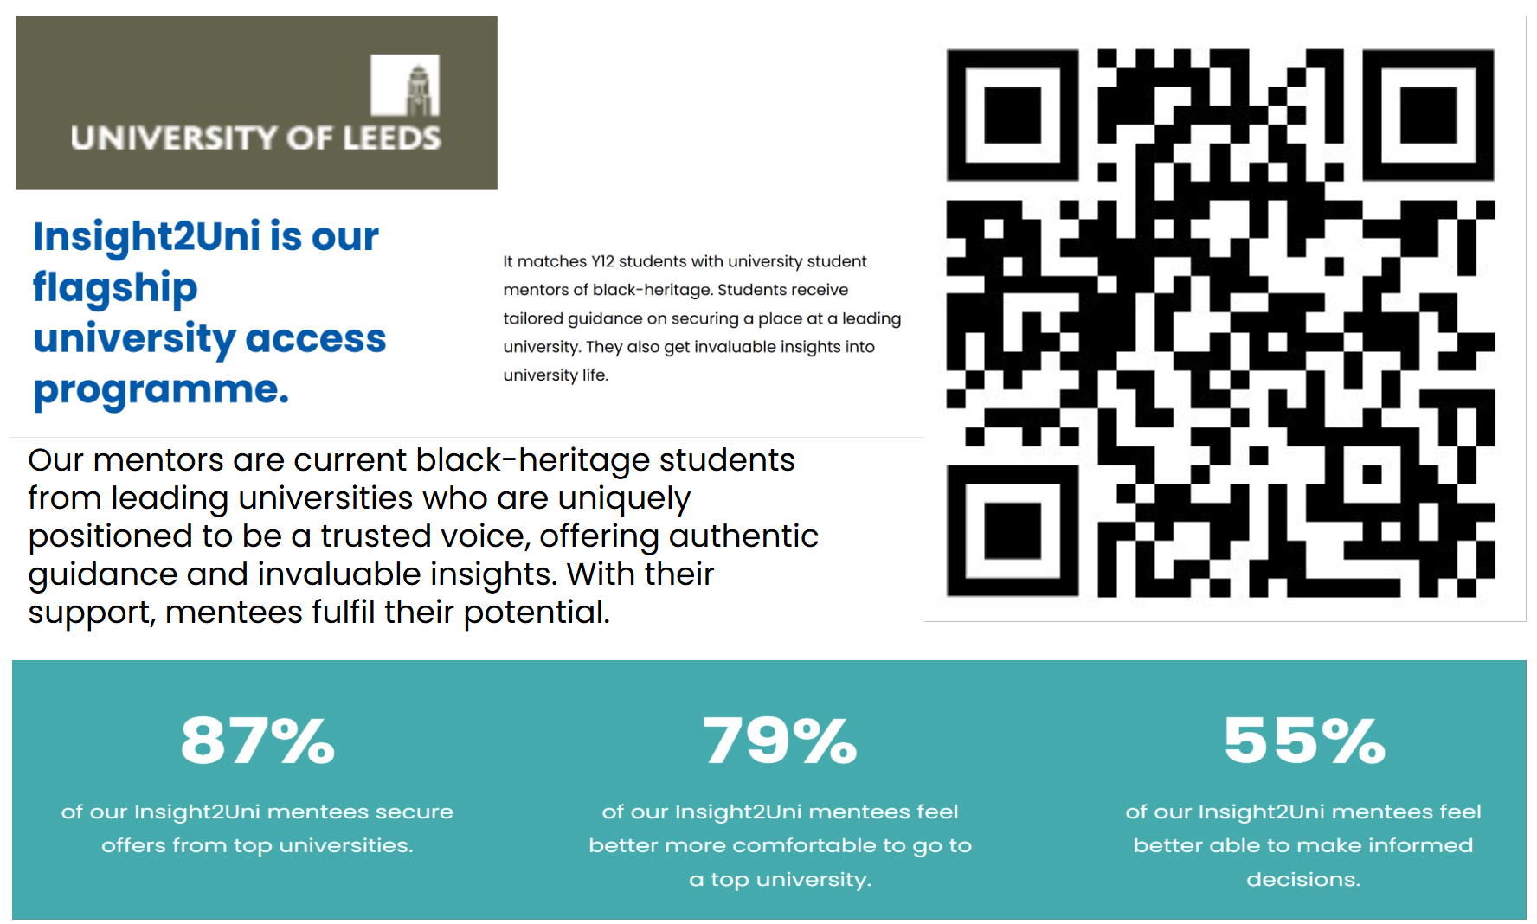
Insight2Uni

Slide 6


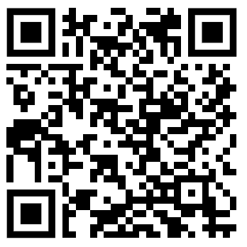

Slide 7



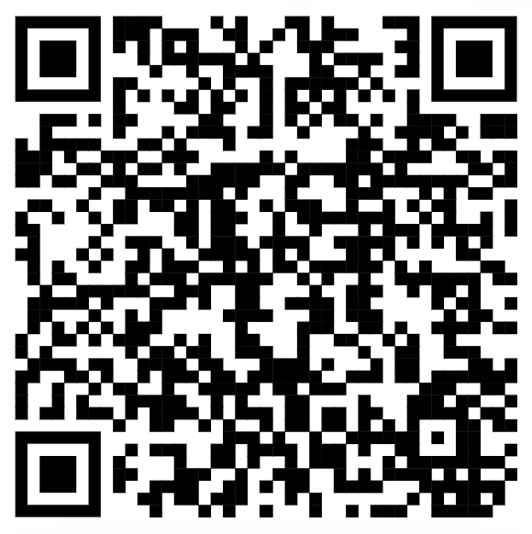

Slide 8

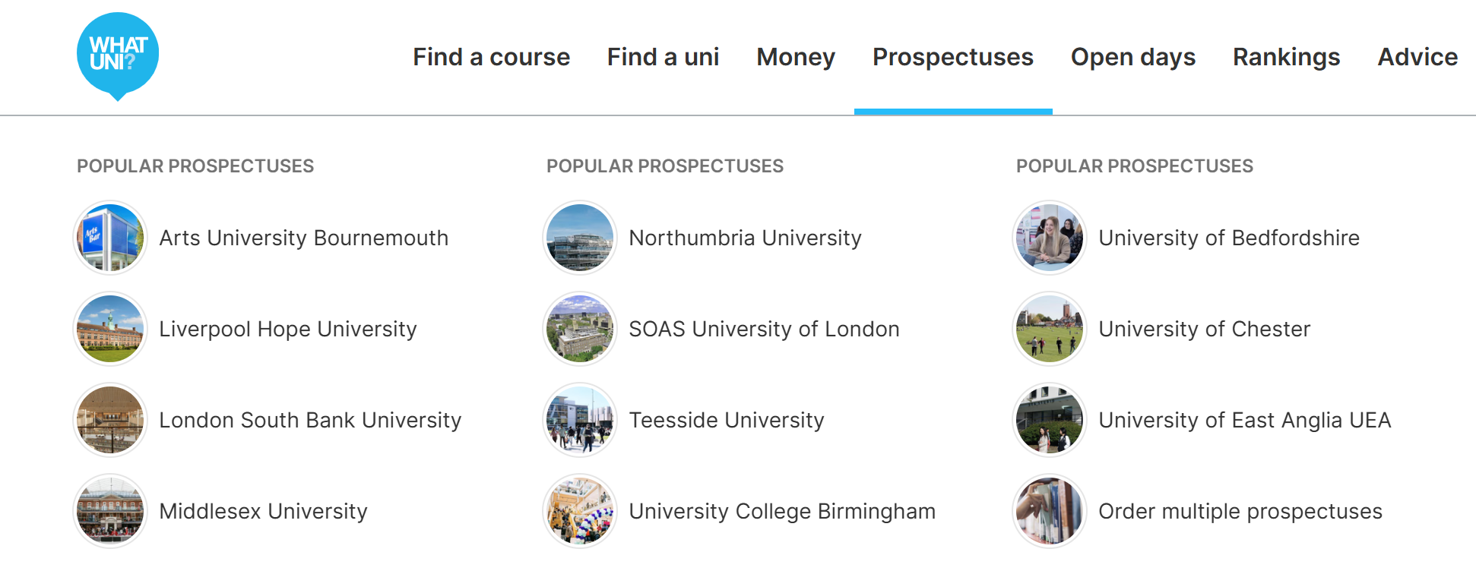
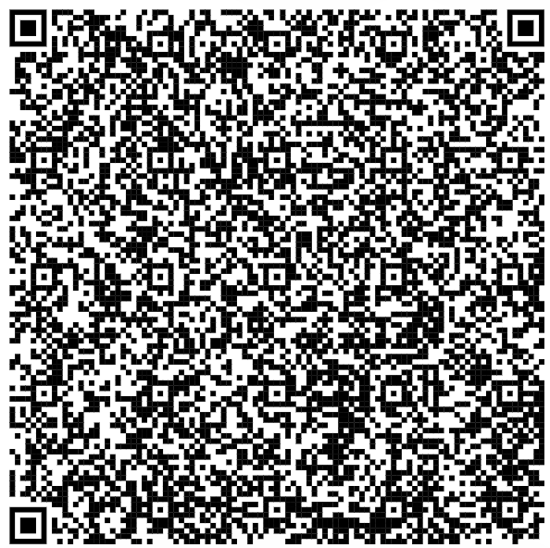
University Open Days and Events
Check out open days and events at universities that are occurring this year! Don't forget to check out the prospectuses.

Slide 9
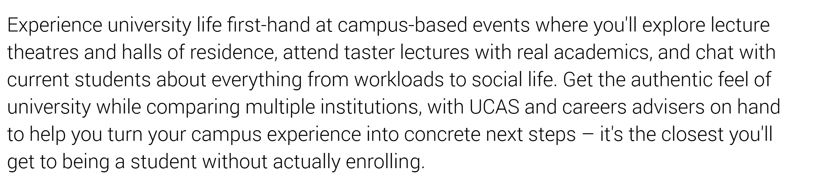
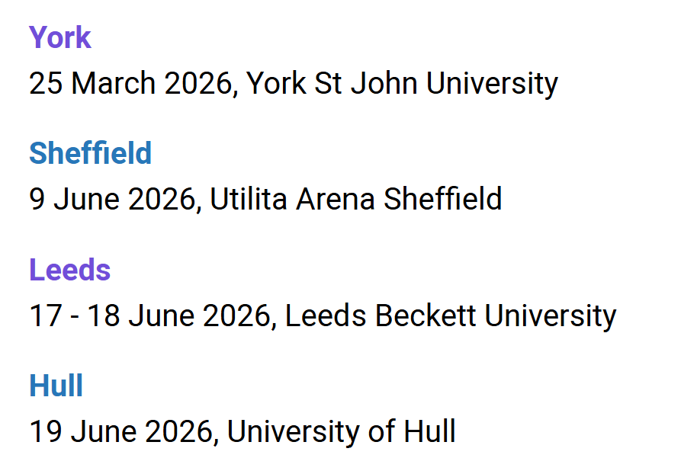
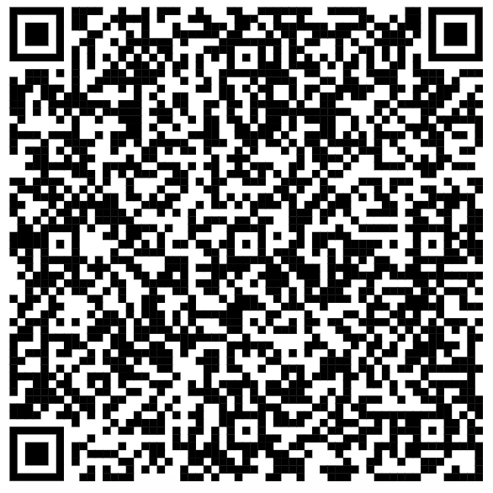
UCAS Discovery Days

Slide 10
Y13

Slide 11
This week's assemblies
Mon – Y12
Tue – Y13 (Y8 in the Sports Hall)
Wed - Y8
Thu – Bronte / Clarke
Fri – Houldsworth / Priestley

Slide 12
Headteacher's Breakfast
Mon – Y13
Tue – Y7
Wed - Y9

Slide 13
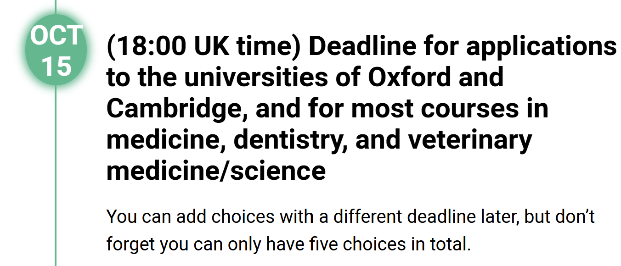

If your UCAS is not complete, it will not be thoroughly checked and you risk it not being sent in time of the UCAS deadline.

Slide 14
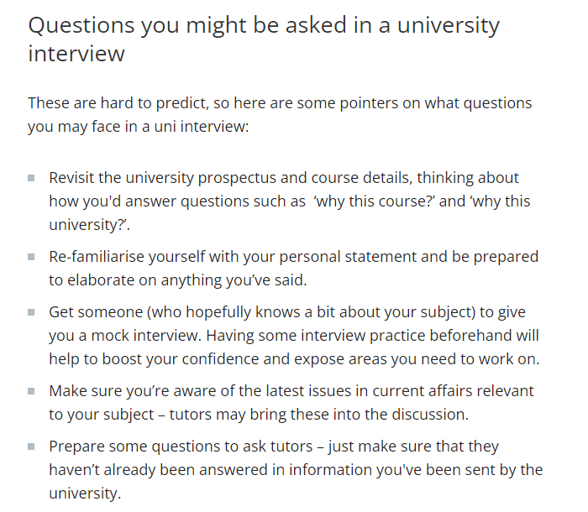
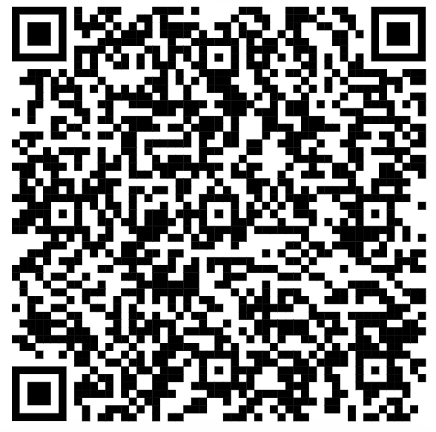
Preparing for Interviews
https://www.theuniguide.co.uk/advice/ucas-application/university-interviews-how-to-prepare
This guide gives some handy tips on how to prepare for university interviews.

Slide 15


Slide 16



Apprenticeship & Employment

Slide 17


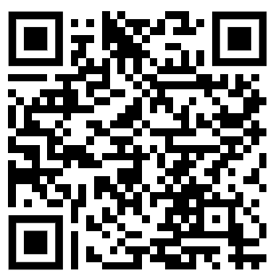
Apprenticeship & Employment
At HSBC, we believe apprenticeships are the future of the workforce – a gateway to valuable skills and meaningful careers. National Apprenticeship Week is a time to celebrate the incredible opportunities apprenticeships offer to young people, parents, and educators.
We are excited to invite your students to join us for our special Open Evening at our regional office in Leeds, where they can experience the world of HSBC apprenticeships firsthand and meet the young people already thriving in their roles as apprentices.
Tuesday 10th February 2026 – 6.30 – 8pm
First Direct, 40 Wakefield Road, Leeds, LS98 1FD

Slide 18

Apprenticeship & Employment

Slide 19

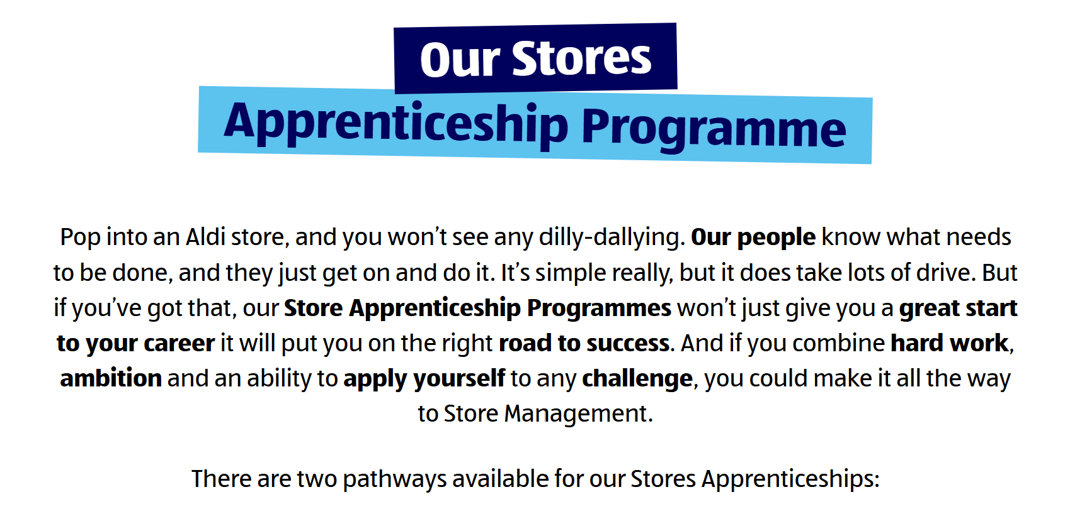

Apprenticeship & Employment

Slide 20


Apprenticeship & Employment

Slide 21


Business, Economics & Finance
Lloyds Banking Group’s Skillsfest returns this Spring, perfectly timed for National Apprenticeship Week. This is a fantastic opportunity for students and parents to:
Step inside Lloyds Banking Group and learn all about apprenticeships
Try out two innovation job simulations, including product design & development, coding using AI, and fraud investigations
Meet and network with current apprentices on Lloyds’ schemes
Event Details:
Skillsfest Leeds: Saturday 31 January – 10:00 & 14:00
New for 2026: To ensure everyone can join, we’re introducing Virtual Skillsfest on
Saturday 7 February, running throughout the day.
In total, 2,500 free spaces are available – tickets go quickly!

Slide 22
Humanities, Arts & Social Sciences

Slide 23
Medicinal Sciences

Slide 24
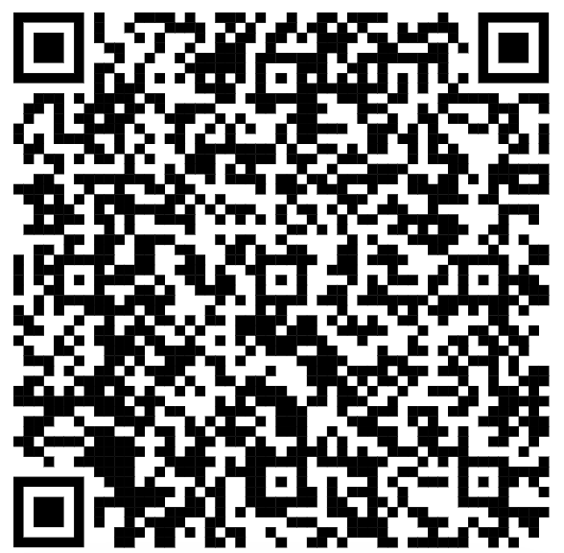
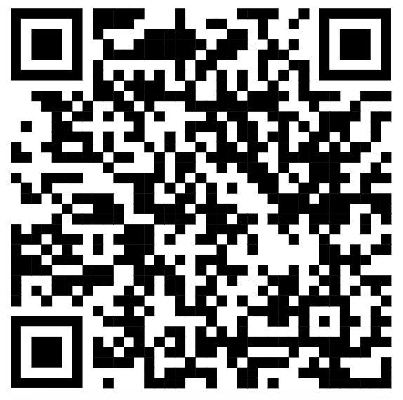
Oxbridge
Check out these podcasts from Trinity Hall Cambridge:
What makes a good Cambridge interview??
https://www.youtube.com/watch?v=AMNW6Iv7RBg&list=PLajElQBmQs8H5GtvnX2yehH4uSMXyZti9&index=13
Cambridge from the Inside #1: Introductions
https://www.youtube.com/watch?v=9HOMRN30SKA

Slide 25
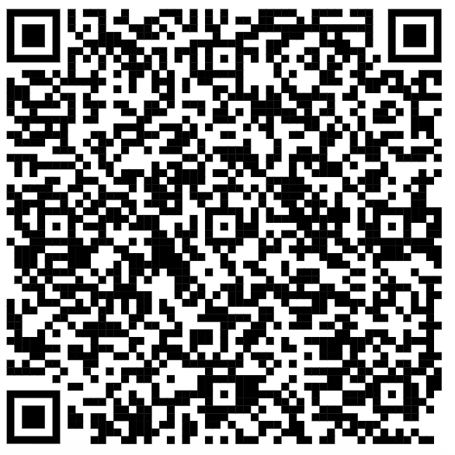
Oxbridge
You’ll Fit In is a webinar series and residential programme for Year 12 students in the UK from underrepresented ethnic backgrounds. The central aim of the programme is to both support students with all aspects of the admissions process but also to reassure applicants that, if they were to apply and obtain an offer, they would not feel out of place socially while studying at Cambridge.
For full details on the programme, including the link to sign up, please visit our website here: You'll Fit In - Trinity Hall Cambridge

Slide 26

Oxbridge
A fantastic way to explore your options and make informed choices, if you are thinking of Veterinary Studies
If you have any issues when booking, contact: tutorial.office@vet.cam.ac.uk

Slide 27
Oxbridge
Selwyn College, Cambridge, which is our partner college, is launching its HEE programme for 2025-2026. This will involve some in-person (at Greenhead) and some online lectures, as well as plenty of online modules and webinars for you to work through. There is a great deal of opportunity to further your super-curricular study throughout the course.
Selwyn is delighted to welcome in another year of the HEE Programme- a series of sessions that help students expand their skillset, build on their super-curriculars and introduce them to a wide array of University subject lectures
Selwyn College Year 12 Higher Education Extension (HEE) Programme 2026 – Fill in form (Link available on Oxbridge Pathways Teams Channel)

Slide 28
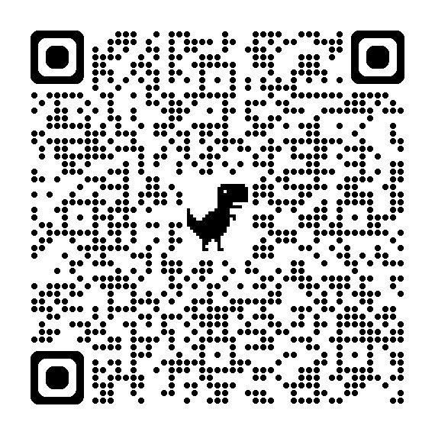
Oxbridge
Think Cambridge 2026
4 to 13 February 2026
Bookings for our Think Cambridge webinar series are now open!
This series aims to inspire students to apply to Cambridge. The sessions will cover a range of topics, including:
an introduction to applying to, and studying at, Cambridge
stories about student life from current students
advice on how to prepare to apply
The webinars are designed for students in:
Year 10 (S3 for Scotland, Year 11 for NI, or international equivalent)
Year 11 (S4 for Scotland, Year 12 for NI, or international equivalent)
Year 12 (S5 for Scotland, Lower Sixth, or international equivalent)
Information about colleges, A-Level choices, and how to apply

Slide 29
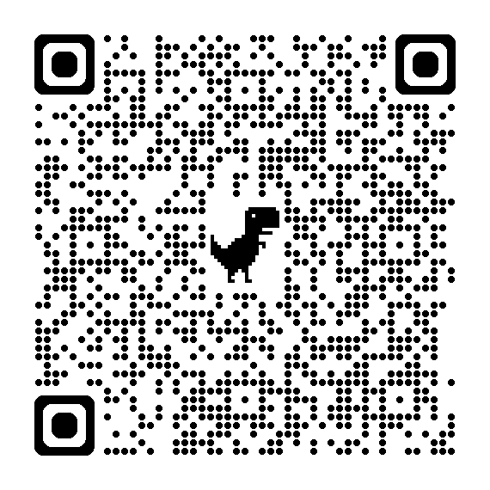
Oxbridge
Scan the QR code for a calendar list of upcoming events by the University of Cambridge to encourage you to think around your subjects and help you decide on your degree course

Slide 30

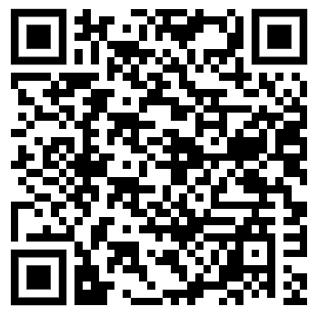
STEM

Slide 31


STEM

