Slide 1
Sixth Form Bulletin

Slide 2
Y12

Slide 3
This week's assemblies
Mon – Y12
Tue – Bronte
Wed – Clarke
Thu – Houldsworth
Fri – Priestley

Slide 4
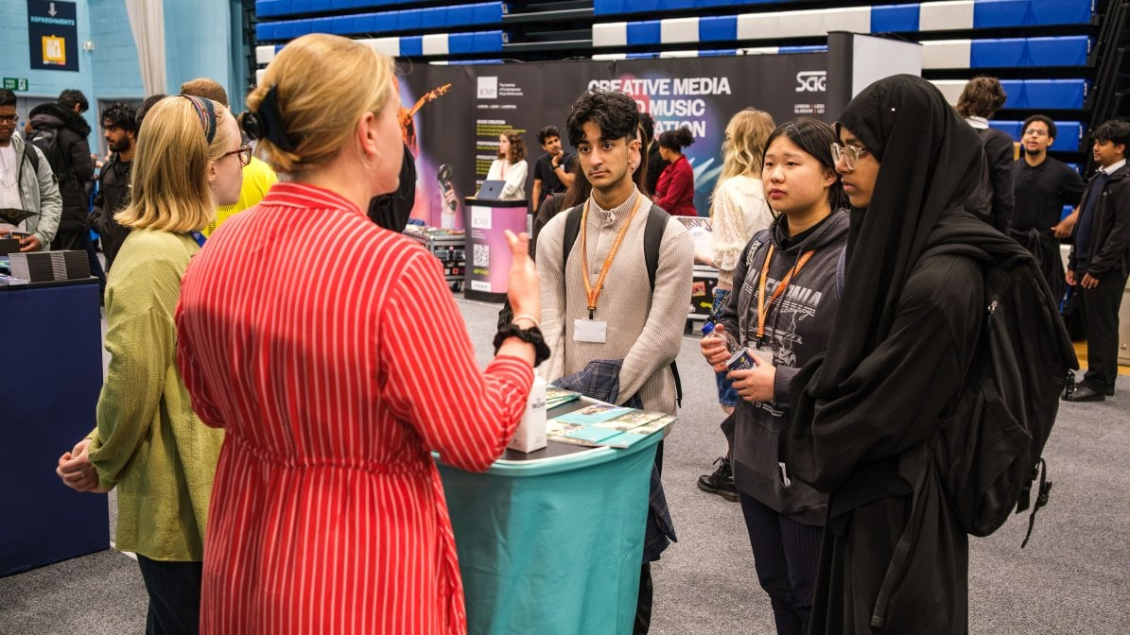
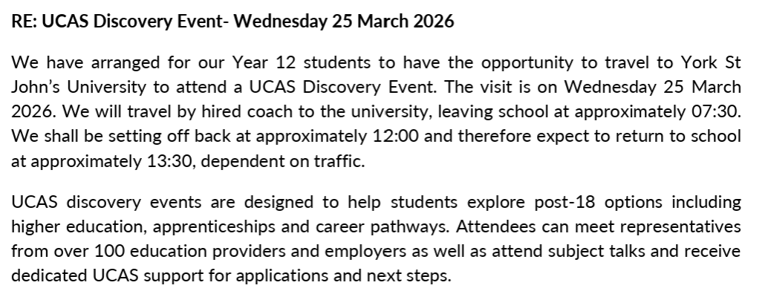
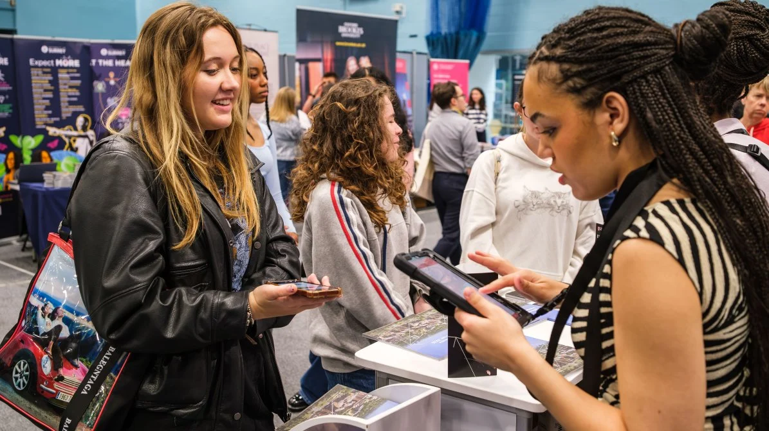
UCAS Discovery Event - York
Deadline for payment and consent is Friday 6th March

Slide 5

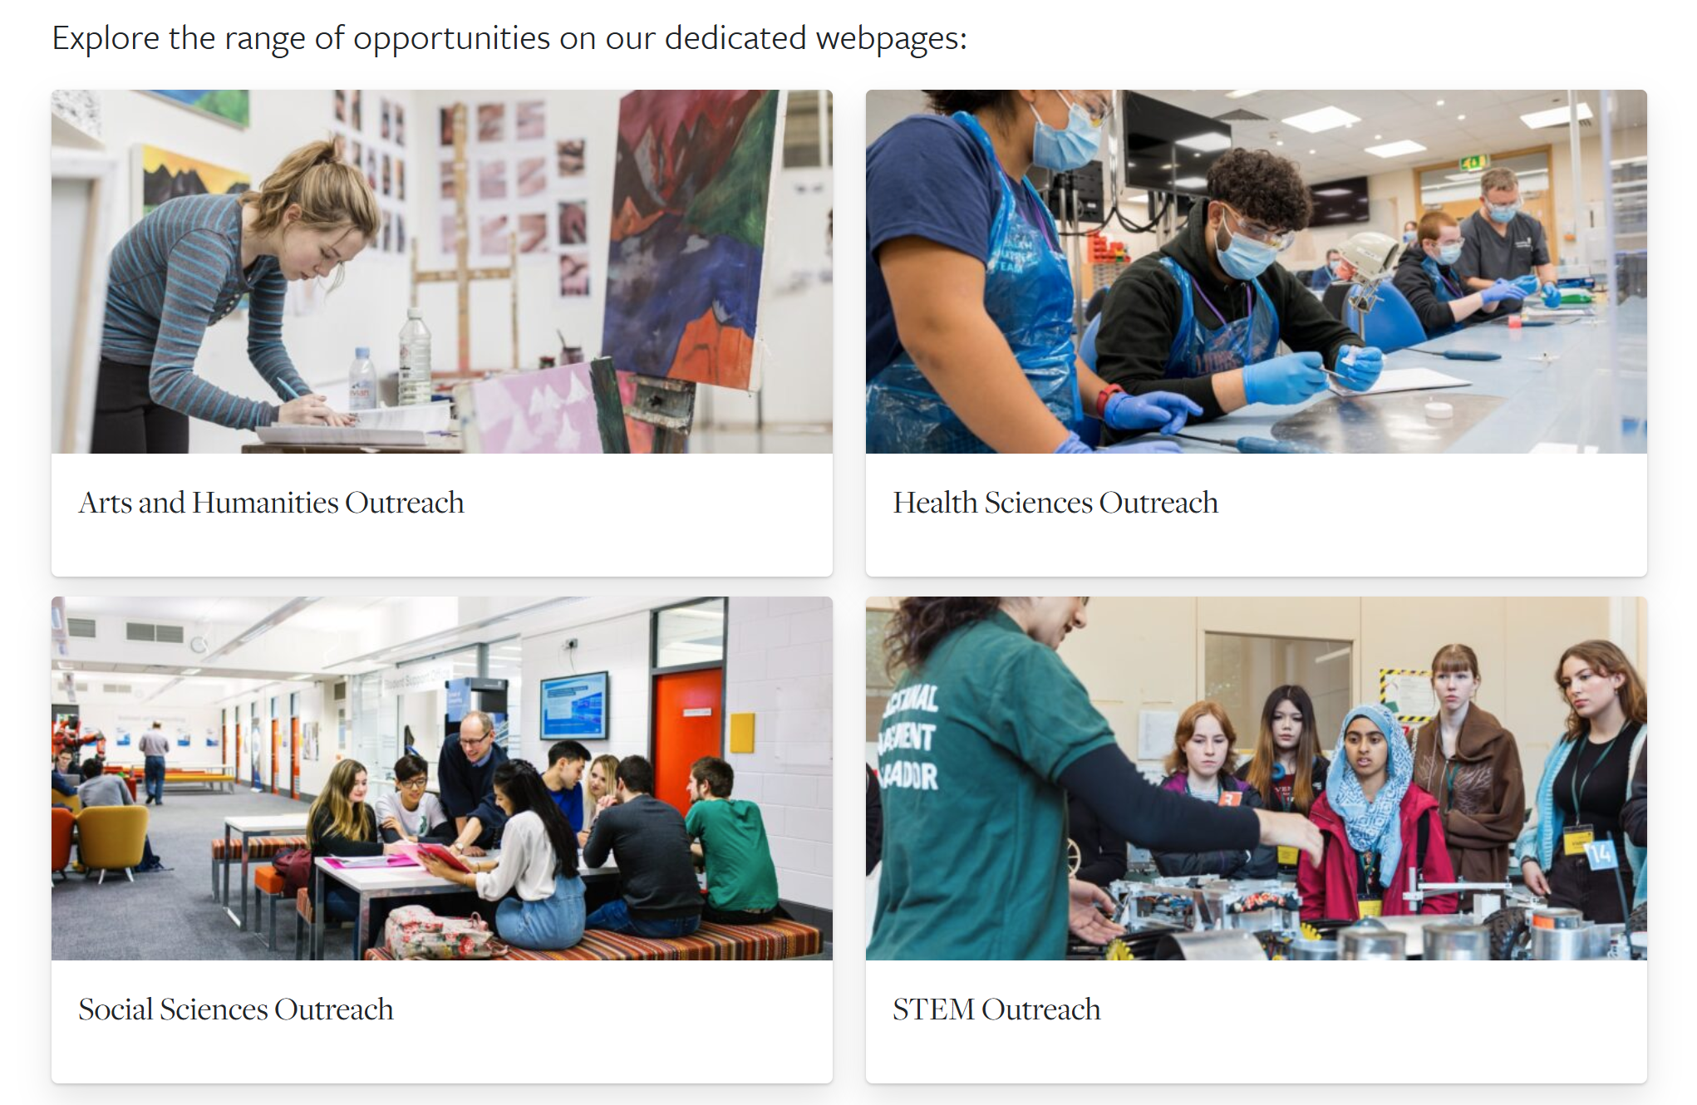
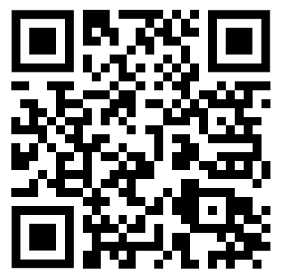
Access & Outreach at Leeds
A reminder that there are lots of opportunities available through the outreach programme at the University of Leeds to support your super curricular activities and engagement with university.

Slide 6

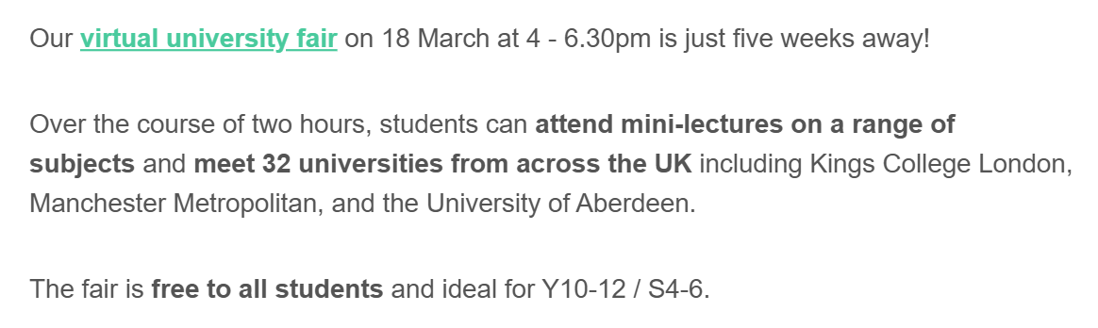
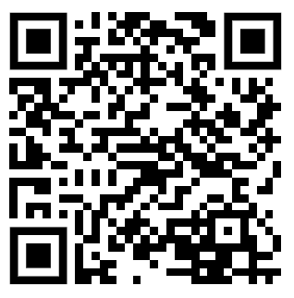
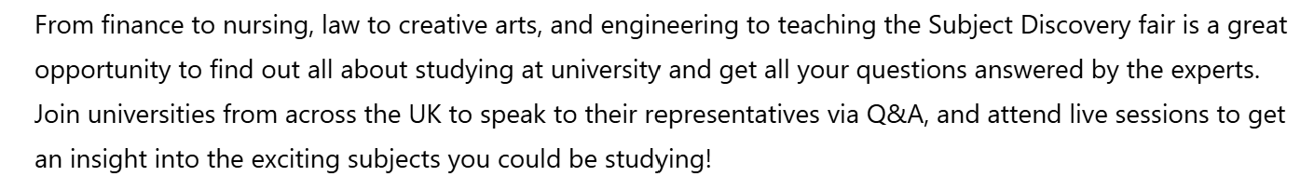

Slide 7

We are celebrating World Book Day at HGS!
2026

Slide 8
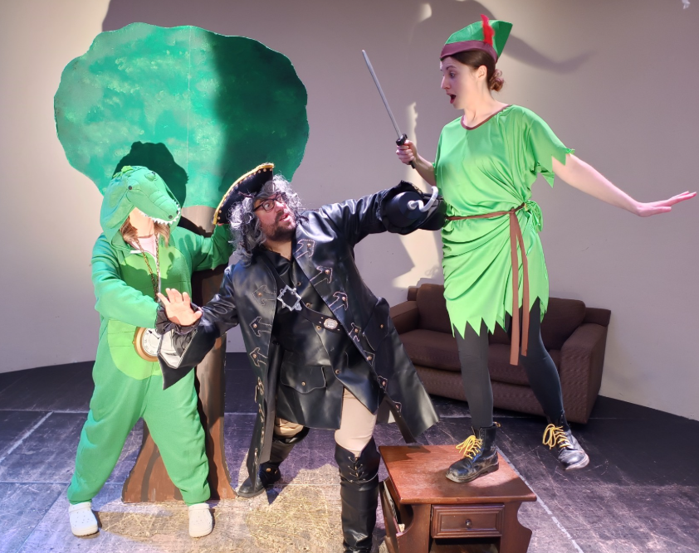
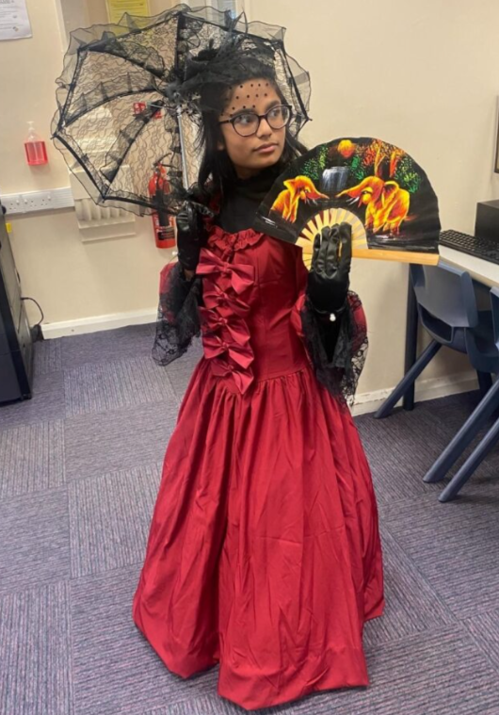
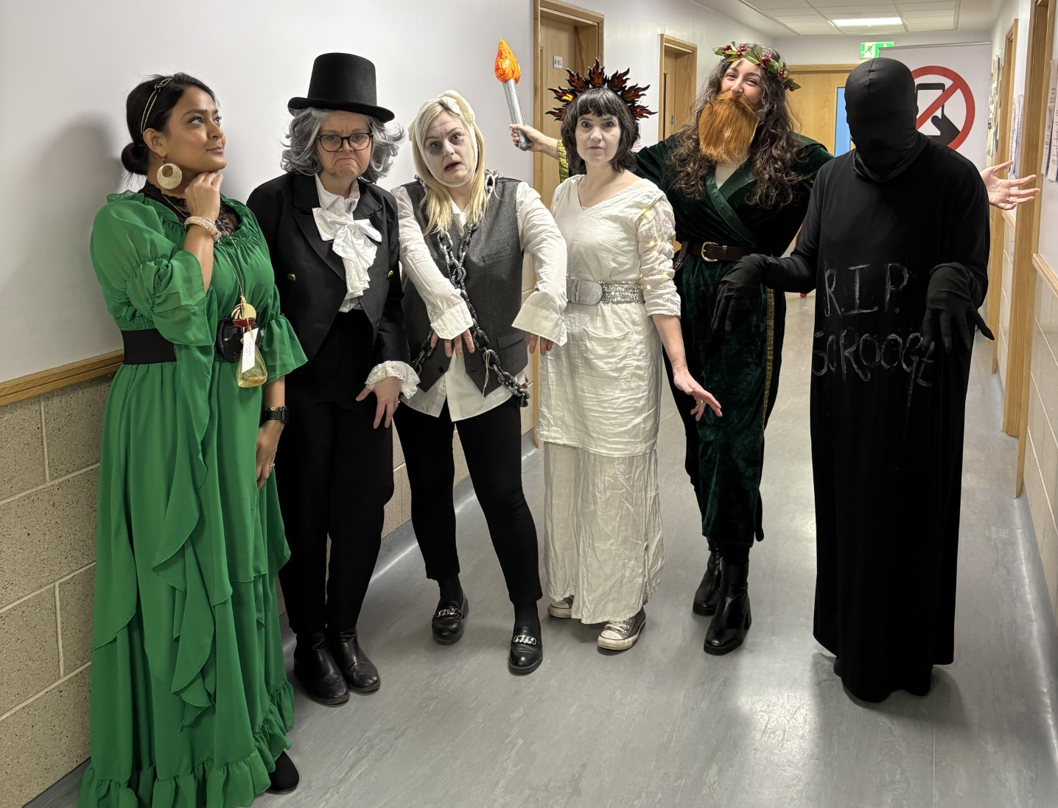
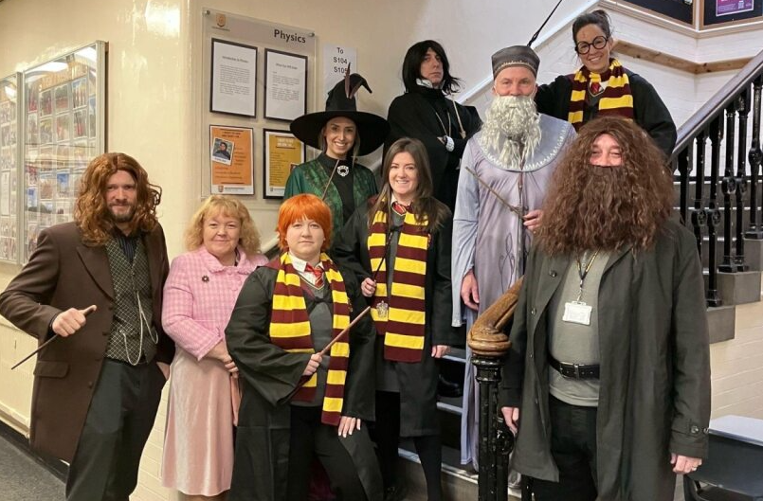
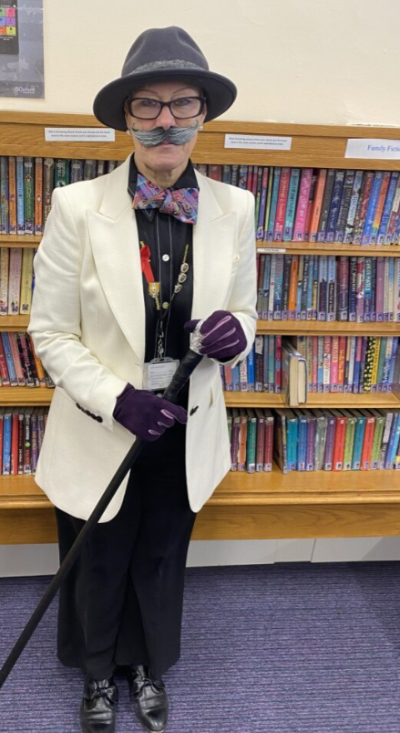
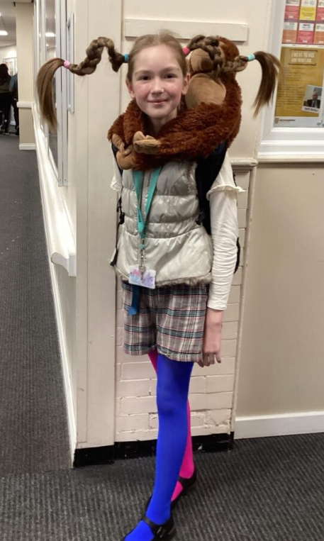
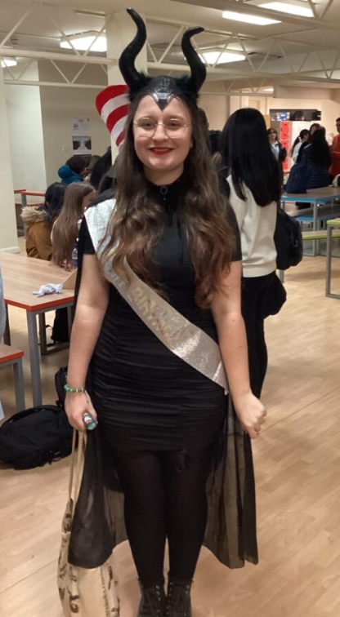
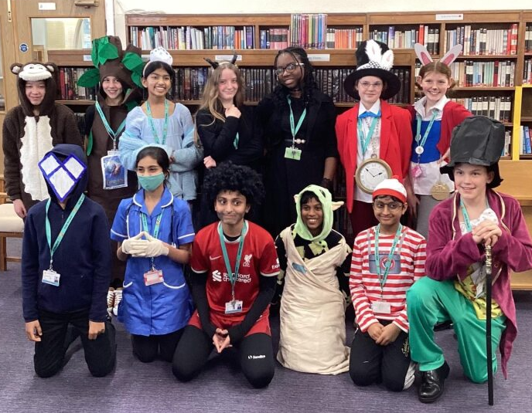
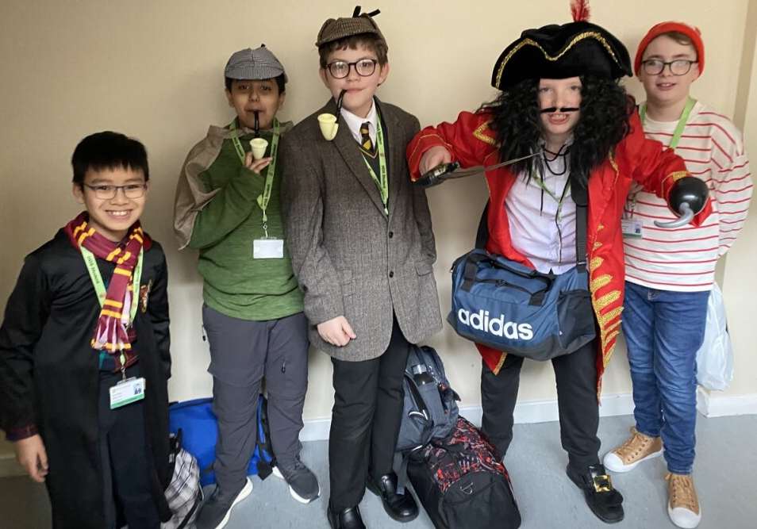
World Book Day is back on the 5th March 2026!
Here's the fun of the last few years:

Slide 9
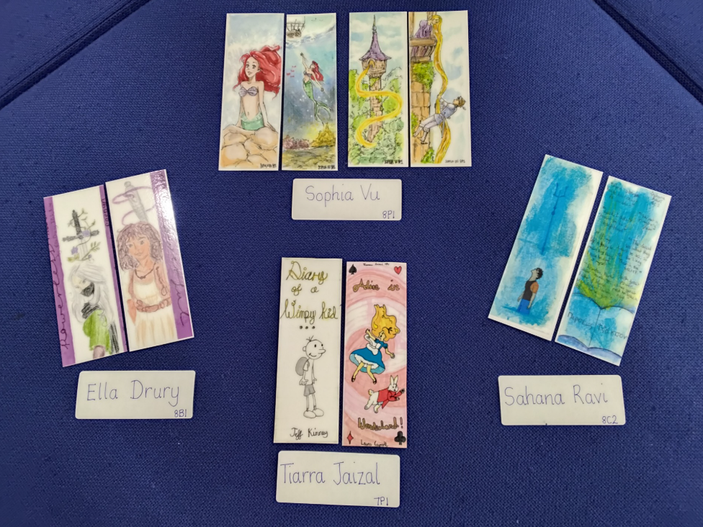
Bookmark Competition
Create a bookmark with a literary theme about a book, author, genre, or to celebrate books and reading.​
The winning bookmark will receive a prize and be reproduced and distributed to students throughout the year.​
Collect your entry pack from The Library from Monday 3rd March.​
Entries must be in by 3.30pm on Friday 6th March.
2026

Slide 10

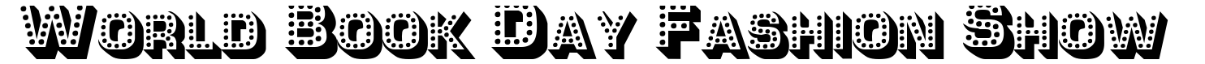
Taking place in the Swann Hall on:
Thursday 5th March at lunchtime!
Arrive at the timeslot for your house, see below:
2026
Catwalk timeslots:
12:30 Bronte
12:40 Clarke
12:50 Houldsworth
1:00 Priestley
Points and prizes for:​
Total entries per house​
Best student costume per house
Best staff costume per house

Slide 11

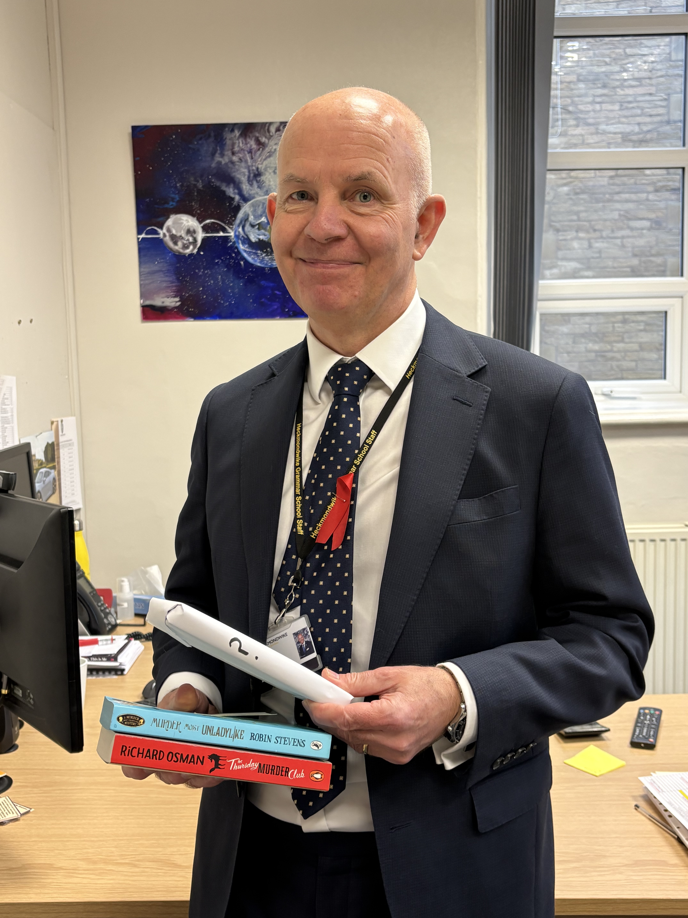
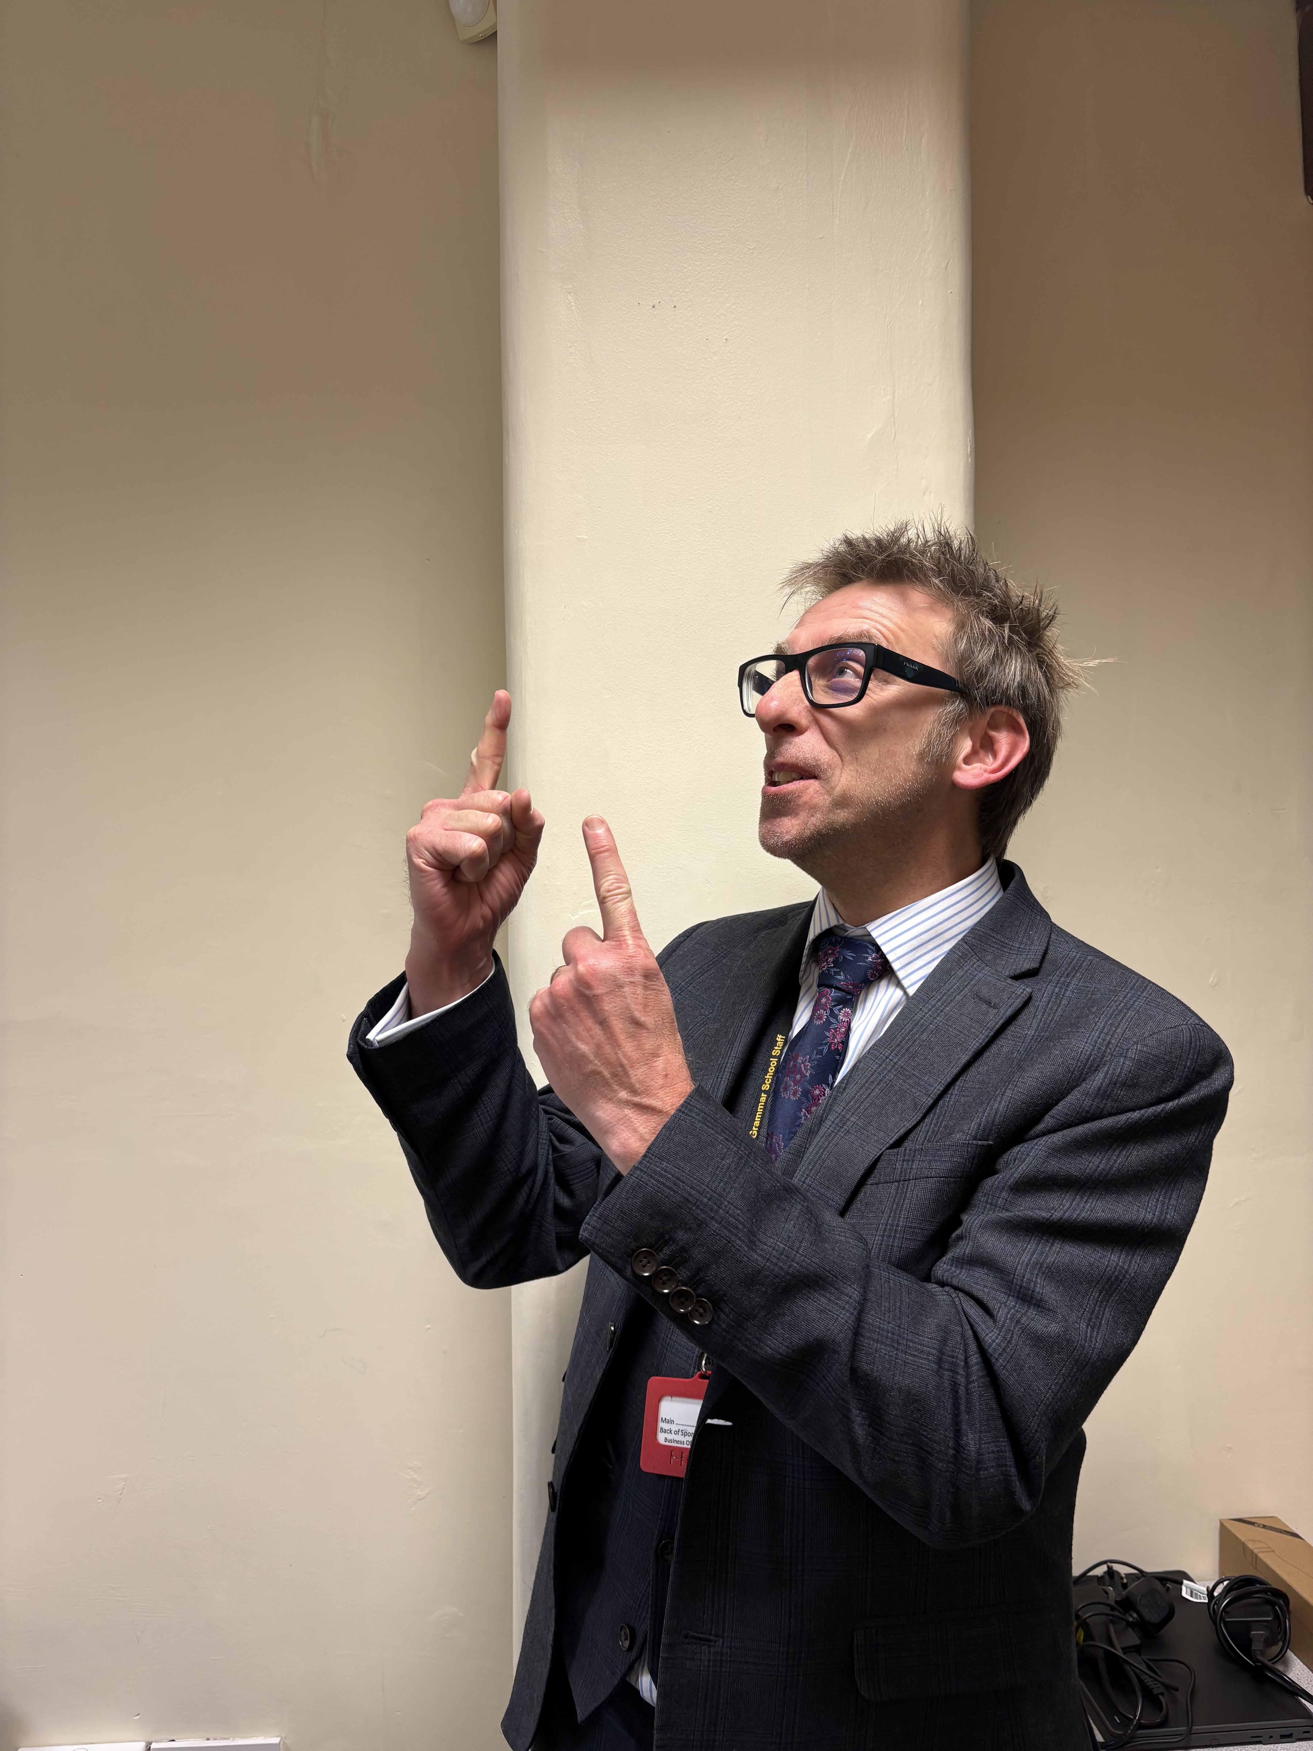
The Case of the Stolen Book: A revenge most sweet.
2026
Mr Roberts has taken a stand after being the victim of book theft for two years running. He has taken back the books Mr Tipler stole from him – plus one more as payback!
Come and take part in the Stolen Book Treasure Hunt to see if you can work out which one.
There are prizes for the fastest detectives!
Join the hunt at lunchtime in The Library:
Friday 6th March

Slide 12

LEEDS UNIVERSITY AND APPRENTICESHIP FAIR

Slide 13
Y13

Slide 14
This week's assemblies
Mon – Y12
Tue – Bronte
Wed – Clarke
Thu – Houldsworth
Fri – Priestley

Slide 15
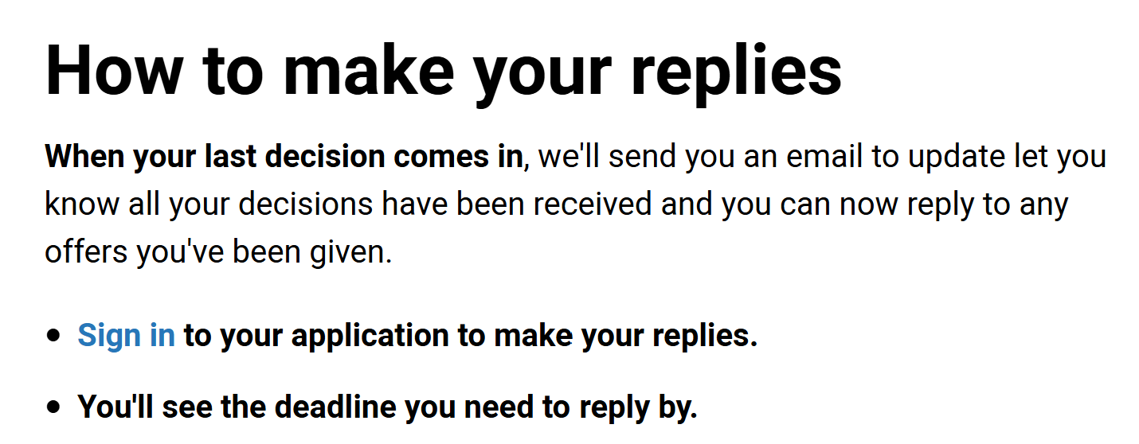
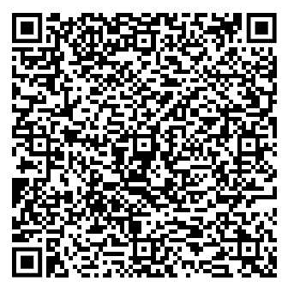
UCAS Useful Links

Slide 16

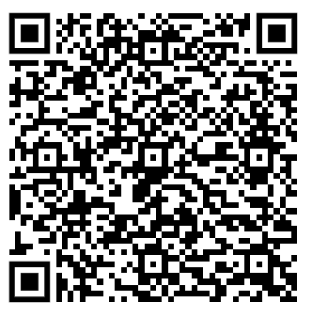

UCAS Useful Links

Slide 17

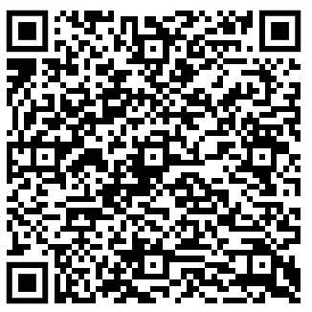
UCAS Useful Links

Slide 18
We are celebrating World Book Day at HGS!
2026

Slide 19
World Book Day is back on the 5th March 2026!
Here's the fun of the last few years:

Slide 20
Bookmark Competition
Create a bookmark with a literary theme about a book, author, genre, or to celebrate books and reading.​
The winning bookmark will receive a prize and be reproduced and distributed to students throughout the year.​
Collect your entry pack from The Library from Monday 3rd March.​
Entries must be in by 3.30pm on Friday 6th March.
2026

Slide 21
Taking place in the Swann Hall on:
Thursday 5th March at lunchtime!
Arrive at the timeslot for your house, see below:
2026
Catwalk timeslots:
12:30 Bronte
12:40 Clarke
12:50 Houldsworth
1:00 Priestley
Points and prizes for:​
Total entries per house​
Best student costume per house
Best staff costume per house

Slide 22
The Case of the Stolen Book: A revenge most sweet.
2026
Mr Roberts has taken a stand after being the victim of book theft for two years running. He has taken back the books Mr Tipler stole from him – plus one more as payback!
Come and take part in the Stolen Book Treasure Hunt to see if you can work out which one.
There are prizes for the fastest detectives!
Join the hunt at lunchtime in The Library:
Friday 6th March

Slide 23


Slide 24


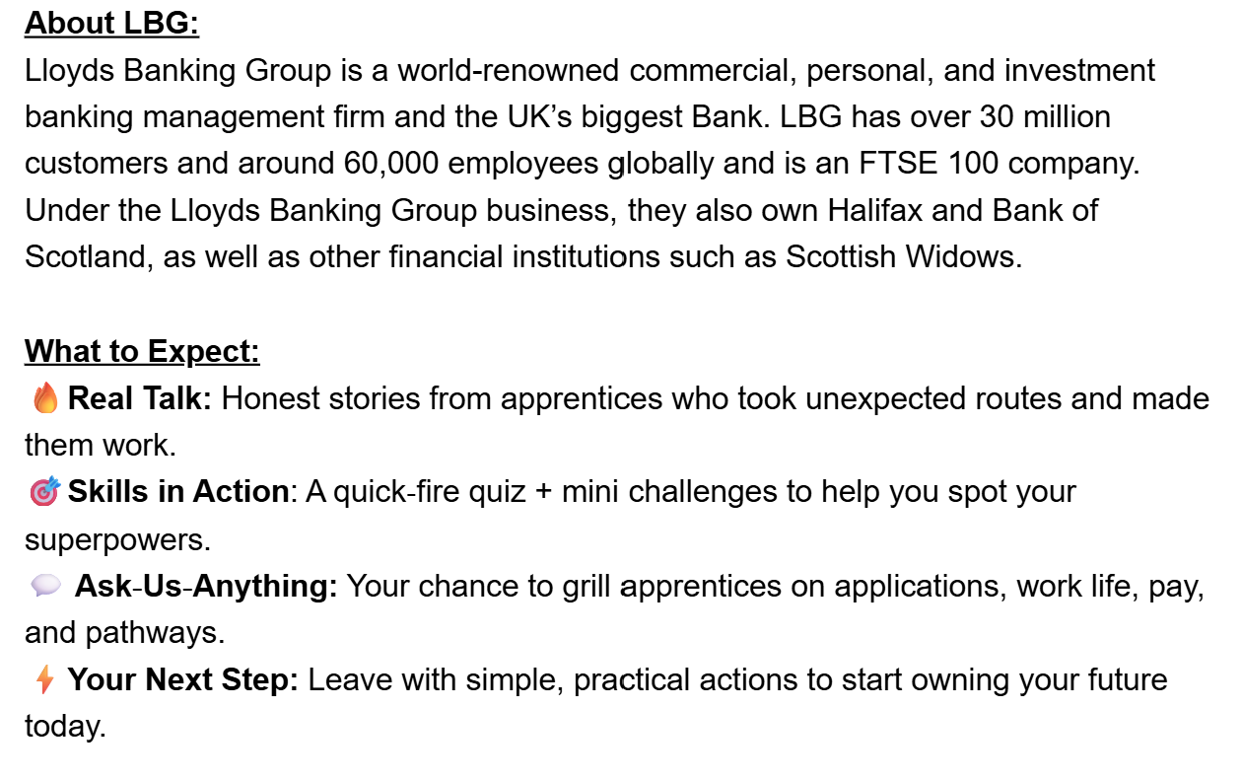
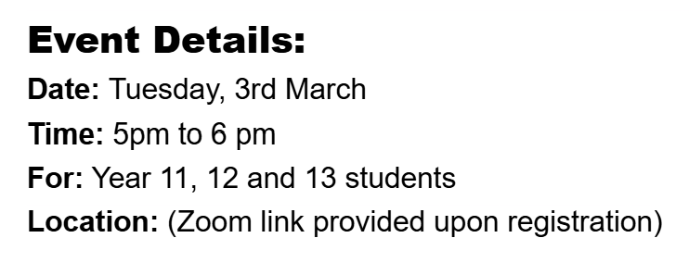
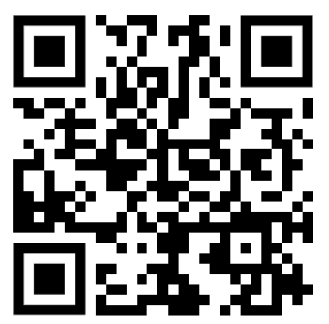
Apprenticeship & Employment

Slide 25

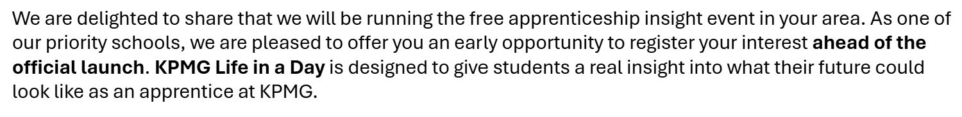
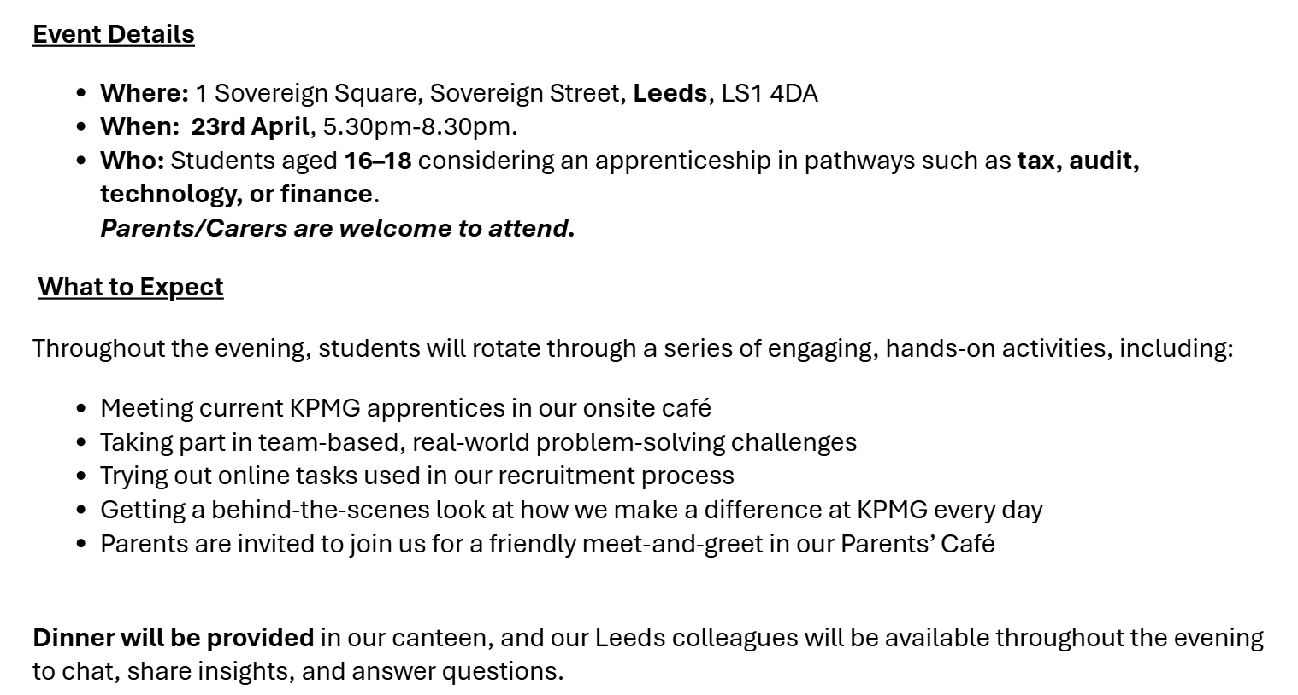

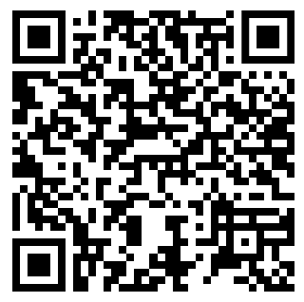
Apprenticeship & Employment

Slide 26


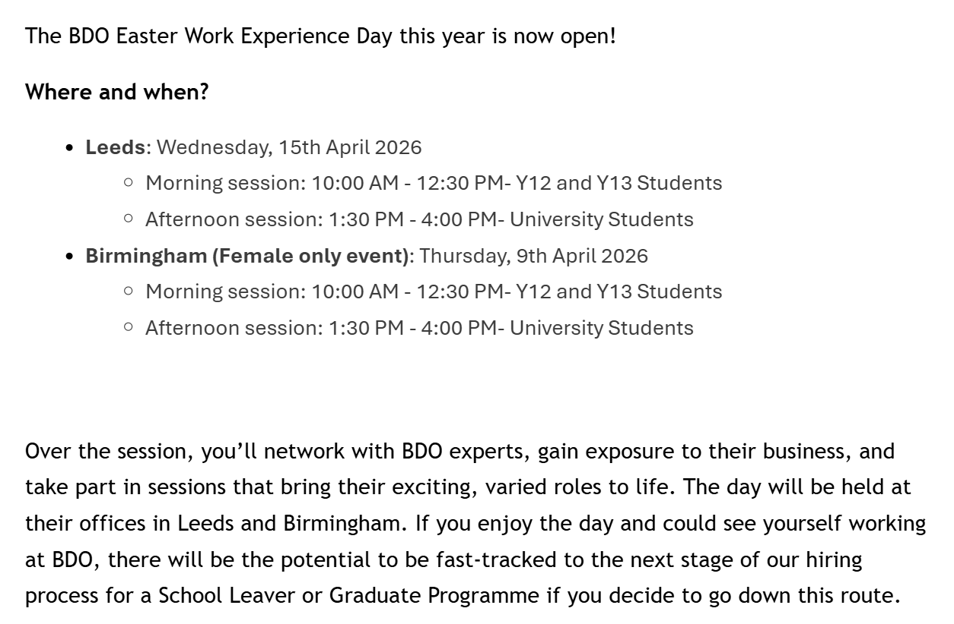
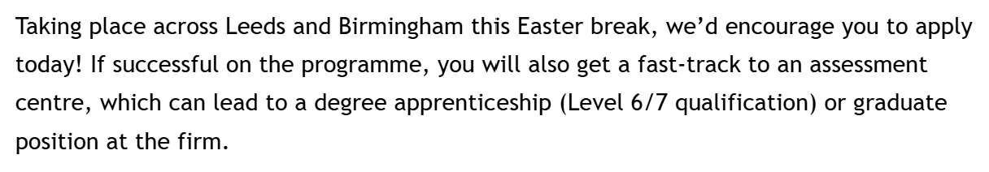
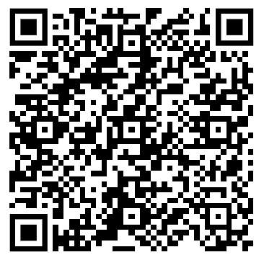
Business, Economics & Finance

Slide 27
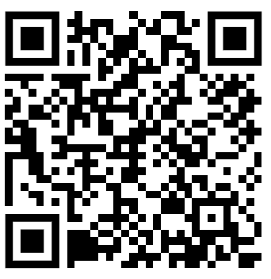

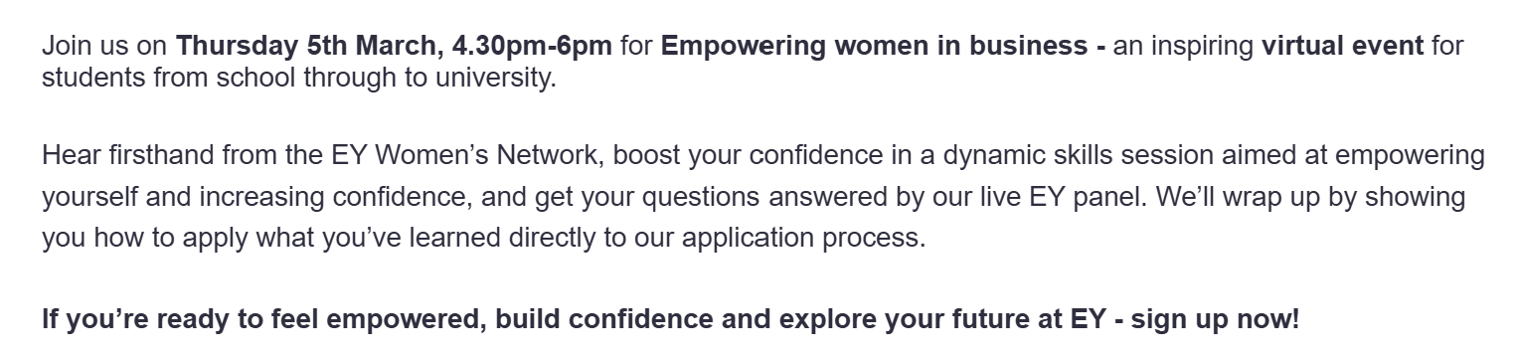
Business, Economics & Finance

Slide 28

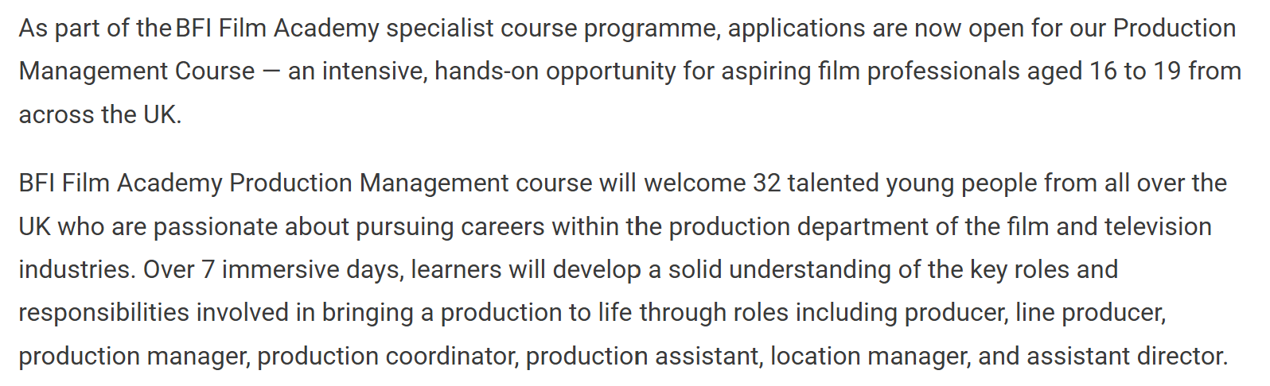
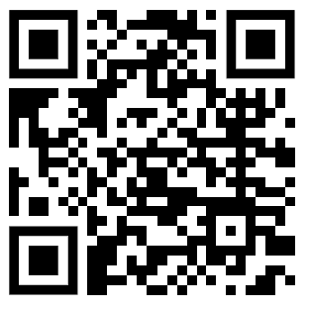
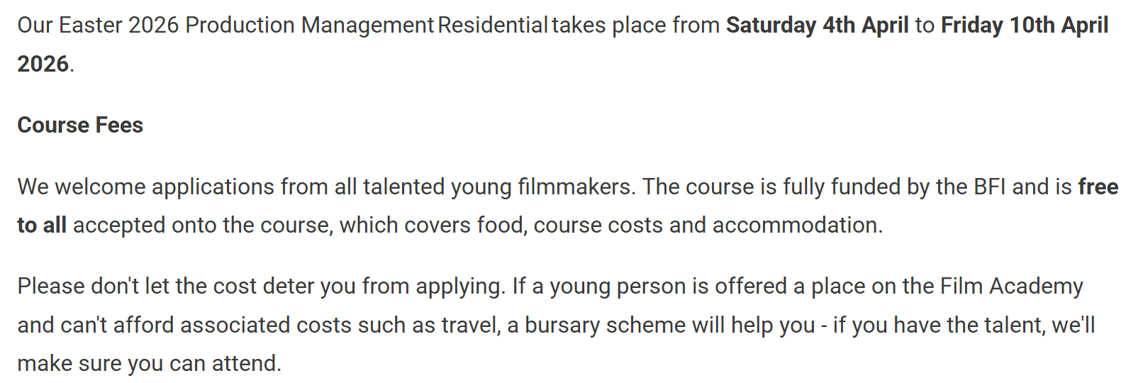
Humanities, Arts & Social Sciences

Slide 29

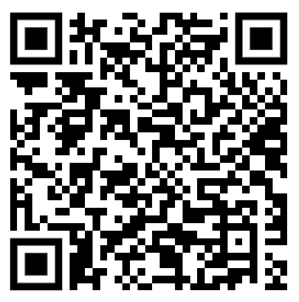
Medicinal Sciences

Slide 30
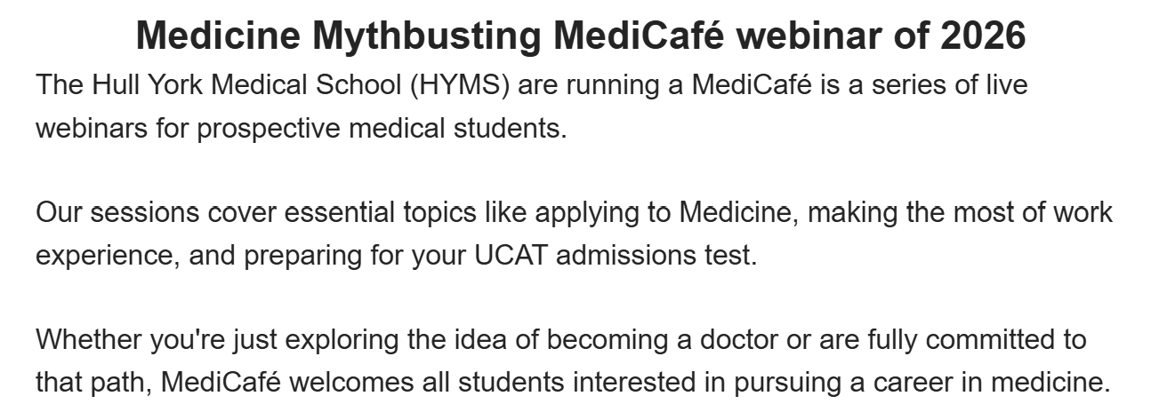

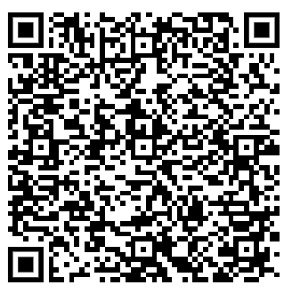
Medicinal Sciences

Slide 31
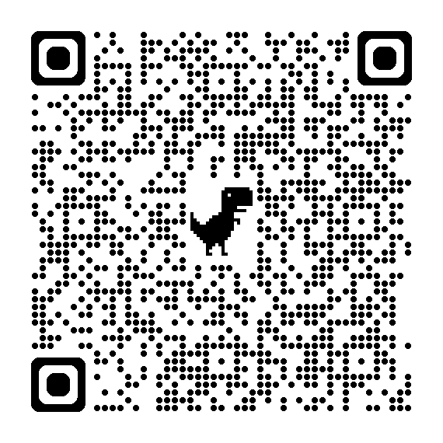
Oxbridge
Supercurricular Exploration
Scan the QR code for a calendar list of upcoming events by the University of Cambridge to encourage you to think around your subjects and help you decide on your degree course

Slide 32
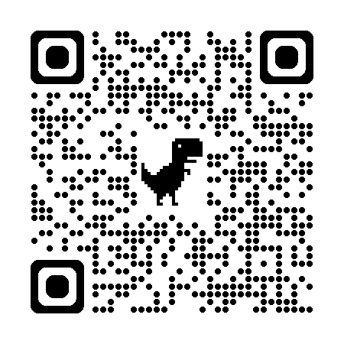
Oxbridge
Supercurricular Exploration!
Scan the QR code for a calendar list of upcoming events by the University of Oxford to encourage you to think around your subjects and help you decide on your degree course

Slide 33
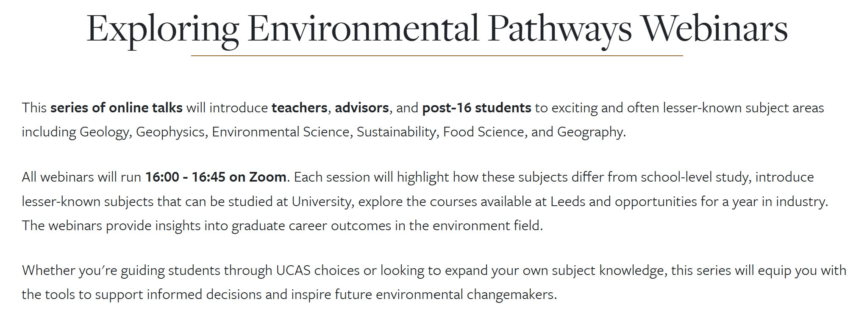
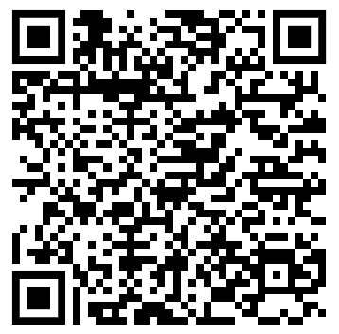

STEM

